Slide 1
Specialist National Professional Qualifications (NPQs)
An introduction to the specialist NPQLBC programme (Leading Behaviour and Culture)
Notes:
Welcome
Where from in world?
Being recorded
Q&A box
Introductions
Intros:
Laura – Lead Facilitator for Specialist NPQ Programmes
Jamie, waiting room, recording and sales – and Kai - Sales
Joseph Gliddon - e-learning
Alison Longvill – partner
Kirsty Elliot - ex participant
Poppi Birtle – ex participant
Welcome
Really excited to be working with you
Info and insight into the specialist NPQs, what’s different about them from the previous iteration of NPQs, who enrols on which programmes and an insight into BPN’s approach and programmes

Slide 2
NPQ programmes: what changed in 2020?
So what’s changed?
Through the revised Initial Teacher Training Core Content Framework and the implementation of the Early Career Framework, the DfE are now supporting teachers in the first years of their career with a structured two-year induction into the profession
NPQ content areas are threaded from the Early Career Framework
The NPQs and New Headteacher Programme build on this foundation to provide continuous career pathways with training and support for teachers and leaders at all levels (with Teaching content from the ECF in all of the specialist NPQs)
The revised suite of specialist and leadership NPQs will complete the golden thread from initial teacher training through to school leadership, rooting teacher and leader development in the best available evidence and collective wisdom of the profession
Notes:
USE HEADLINE INFO ONLY
We want to start by providing some clarity about the journey and development NPQs have gone through
What’s fantastic about the NPQs is that they’ve become part of a very clear career pathway which starts with the trainee teacher and ITT, into the ECF and then onto NPQs with the specialist route programmes, and then senior leaders, headteachers and executive leaders – brings everything together, and provides a very clear pathway and golden thread that the government have been keen to create
CLICK
ITT and ECF means early career teachers are supported in the first 2 years of their teaching careers
The NPQs follow on from there and many of the NPQ content areas are threaded from the ECF
Rooted in evidence and collective excellent practice from the profession
Jamie, would you mind posting the DfE’s framework for the NPQLTD into the chatbox please?

Slide 3
NPQ programmes: what changed in 2020?
Specialist NPQs
Leadership NPQs
NPQ Leading Teaching (NPQLT) | For those who lead, or aspire to lead teaching in a subject, year group, key stage or phase
NPQ Leading Teacher Development (NPQLTD) | For those who lead, or aspire to lead the development of other teachers
NPQ Leading Behaviour & Culture (NPQLBC) | For those who lead, or aspire to lead behaviour and culture and/or pupil well-being
NPQ Senior Leadership (NPQSL) | For those who are, or aspire to be, senior leaders leading across a school
NPQ Headship (NPQH) | For those who are, or aspire to be, headteachers leading across a whole school
NPQ Executive Leadership (NPQEL) | For those who are, or aspire to be, executive leaders with responsibility across more than one school
So what’s changed?
Specialist NPQs support career pathway width and replace old NPQML
Assessed school-improvement projects have been replaced with practice-based formative and summative assessment tasks
Behaviours do not feature in DfE frameworks, however, BPN have embedded these throughout
Greater emphasis on practice-based activity and participant context – practice activities, in-school performance coach
Domain-specific evidence base
Notes:
USE HEADLINE INFO ONLY TO POSITION LTD
There is a growing list of NPQ programmes (replacing previous 4 NPQs during the reforms in 2020)
In developing the width of the pathway, the old NPQML has been replaced by the NPQLT, NPQLTD, NPQLBC and NPQLL which provides more choice, opportunity and sense of direction for school leaders, and to become better at what we do and to be able to specialism our knowledge in order to make specific difference to the young people we work with
As you can see, the NPQLBC is 12 months long.
No project – FATs and SAT (more in a min)
No longer any leadership behaviours in the DfE frameworks but BPN have a set that are embedded throughout, alongside leadership skills to enable participants to apply new knowledge into their practice as a leader
Greater emphasis on practice-based activity and participant context – practice activities, in-school performance coach – applying your learning in your own contexts
Domain-(school-)-specific evidence base as opposed to generic evidence-base from previous iterations

Slide 4
Specialist NPQ programmes: assessment
12 month programme followed by summative assessment task
Case study (will only cover content which is referred to in the NPQ Content Framework)
SAT will allow participants to demonstrate understanding of the DfE’s NPQ Framework ‘learn that’ statements and how they can successfully apply this new knowledge through the ‘learn how to’ statements
The SAT will have its own mark scheme and marks will be awarded for both 'learn that' and 'learn how to' statements
The SAT submission is 1,500 words: participants receive the unseen case study at the start of an eight-day assessment window and submit their response by midnight of the eighth day
This SAT window falls 12-15 months after the start of the programme.
Participants are required to meet 90%+ engagement as well as a successful SAT to pass their programme
Notes:
USE HEADLINE INFO ONLY
No longer a school improvement project - now a streamlined summative assessment task at the end of the programme
Application of learning in practice is now the focus and the final assessment follows the 12 months of engagement and learning through an unseen case study scenario where responses need to be 1500 words – much lower expectation in terms of word count, but the requirement for completion is much tighter to fit in with the within an 8-day period
In order to undertake the SAT at the end, you will need to engaged with at least 90% of the programme elements

Slide 5
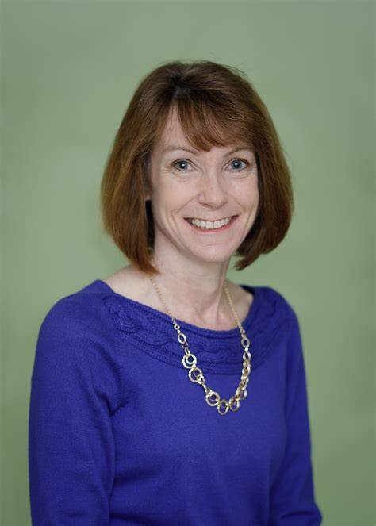
Specialist NPQ programmes: who can enrol
NPQ Leading Behaviour & Culture | For those who lead, or aspire to lead behaviour and culture and/or pupil well-being
Notes:
So, the DfE have designed the frameworks for each of the NPQs to support you all to specialise based on your different interests, or experience or potential expertise, so we know that the LBC is broadly for …….
What’s important to know at this stage is that the DfE framework outlines what needs to be covered in the NPQ, but lead providers such as Best Practice Network have designed how you learn that, and our programmes have been written to be highly inclusive and suit diverse experiences, so I’m going to take you through a few participant case studies to demonstrate the range of participant contexts:
CLICK Cath: LBC – Cath is a highly experienced teacher and leader in schools and her new role is to lead the work in her large primary team in a challenging area in the south west of England as Head of Culture. The school is experiencing issues with pupil behaviour and staff consistency and turnover so she wants to better understand how to lead with a focus on behaviour and culture as opposed to previous lenses such as teaching and learning, but knows this needs to be closely linked to the SDP.
CLICK Ryan: LBC – he works in an all-through PRU in the north west that faces a great deal of highly complex behavioural needs amongst its small student body. He has great behaviour management with the students he works with daily after 6 years in the profession, but is now interested in looking into leadership as an AHT position is looking imminently available, and he wants to be able to develop his behaviour management into a whole setting approach to leading excellent behaviour, and begin to develop a culture and expectation of excellence before he applies for the role.
We also have participants from SEND, alternative settings like PRUs and outdoor schools, EY settings, HE and FE settings, independent schools, and international schools
Our point here is that our participant body is diverse and all at different points in their teaching and leading careers, with completely different school or setting contexts. The programmes are written to enable all participants to thrive no matter if they are already in a leadership post or aspiring to be in one. What’s important to note here is that this is not the same as the ECT Mentor programme that people access through the ECF when supporting early careers teachers. This is about leading the development of others – those others could include ECTs, but not only ECTs, within a team, department, phase, subject or even school or trust
If your role or phase/team/school priority is to develop behaviour and culture or wellbeing, or behaviours for learning, the NPQLBC could be for you
You can undertake all specialist NPQs if you like, but not at the same time!

Slide 6
Programmes overview: content areas
DfE Framework Content Areas: Specialist NPQs (NPQLT, NPQLTD, NPQLBC) | NPQLT | NPQLTD | NPQLBC
 | 1. Teaching | 1. Teaching | Teaching
 | 2. School Culture |  | 2. School Culture
 | 3. How Pupils Learn | 2. Designing Effective Professional Development | 3. Enabling Conditions for Good Behaviour
 | 4. Subject and Curriculum | 3. Delivering Effective Professional Development | 4. Complex Behavioural Needs
 | 5. Classroom Practice
 | 6. Adaptive Teaching
 | 7. Assessment
 | 8. Professional Development |  | 5. Professional Development
 | 9. Implementation | 4. Implementation | 6. Implementation
DfE Framework Content Areas: Leadership NPQs (NPQSL, NPQH, NPQEL)
1. School Culture
2. Teaching
3. Curriculum & Assessment
4. Behaviour
5. Additional and Special Education Needs/Disabilities
6. Professional Development
7. Organisational Management
8. Implementation
9. Working in Partnership
10. Governance and accountability
Notes:
USE HEADLINE INFO ONLY TO POSITION LT
So, in designing the NPQs, the DfE created a ten content areas which each hold a series of learn that and learn how to statements
This slide shows you how the content areas fit across 3 of the specialist progs, and how they compare to the leadership progs
1st table: Specialist – as you can see, they each cover different content areas that are relevant to the specialism, but all cover ‘teaching’ and ‘implementation’, and ‘professional development’ in some format and they’re highlighted in bold text so that you see where the links are, again important for that golden thread of the career pathway
2nd table: Leadership progs – to compare, leadership route participants you will cover those 10 content areas
So, LTD has 4 content areas, LT has 9, and LBC has 5 – don’t be fooled by LTD and LBC having fewer content areas than LT – it is the same amount of rigour and work involved in all 3!
Crucially, we have structured all of the programmes, both leadership and specialist routes, to cover all of their content areas, offering flow and cohesion through bite-sized activities
At every point participants carry with them a Leadership Development Record which tracks progress and ensures relevance for you as individuals, and work with a nominated in-school performance coach will support you in applying your learning throughout
Underpinning all of these content areas is a very strong and clear evidence base and resource list in each framework and we have linked these to specific school practice that will be presented throughout your programmes to exemplify what the content areas look like in practice, to bring them alive in given contexts and then to challenge you through various different kinds of activities to apply them with relevance to you and your schools.
I mentioned flow and cohesion a moment ago - This group of content areas has guided the way the programmes have been structured and designed…

Slide 7
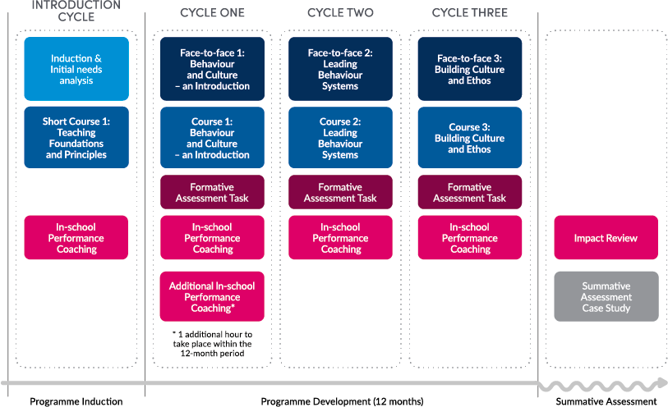
NPQLBC: Programme Structure
Notes:
This slide gives you a timeline of the approximate hours your programme will take you over either the 12 month period
All of BPN’s NPQ programmes follow this cyclical approach
Induction cycle to get you started followed by Cycles 1, 2 and 3
These main cycles – FTF events, online course study, practice activities, FATs and in-school performance coaching
Summative assessment stage

Slide 8
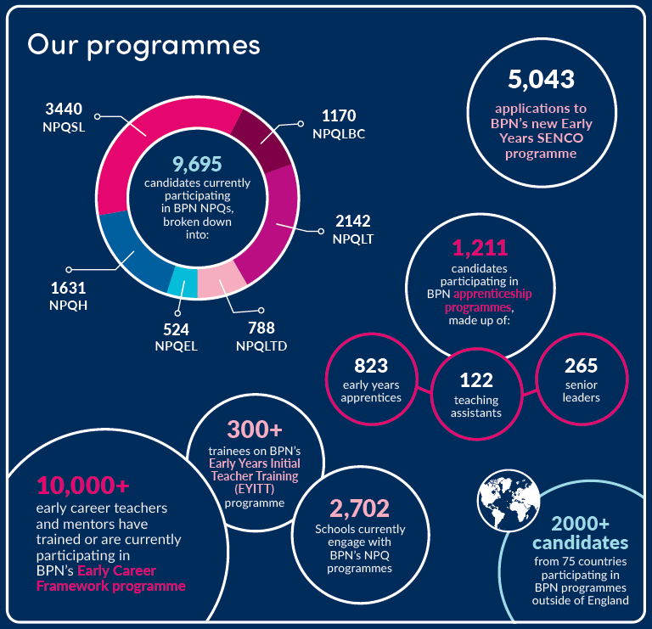
Best Practice Network & Outstanding Leaders Partnership
Every child able to benefit from an excellent education, regardless of background
Every education professional able to grow and give their best
Inspire Learning
Strive for
Excellence
Work
Together
Act with Integrity
Known & Trusted | | | 96% Satisfaction
‘Exceptional’ Provision | | | 96.1% Pass Rate
8
Notes:
A few stats for you…
But also, and possibly even more importantly – a bit about our values: what we stand for – when choosing a provider for your NPQ, it’s important as a leader or aspiring leader to consider the values and approaches through which the provider operates
We’re here to get best leaders for all children, no matter where they are in the world – v important to us
The NPQ work supports your professional learning, through the prog and more importantly ensuring that you’re even better leaders at the end of the programme than you were at the beginning in order get the best for our children and schools
Values: work together, Inspire your learning, through act with integrity, and striving for excellence

Slide 9
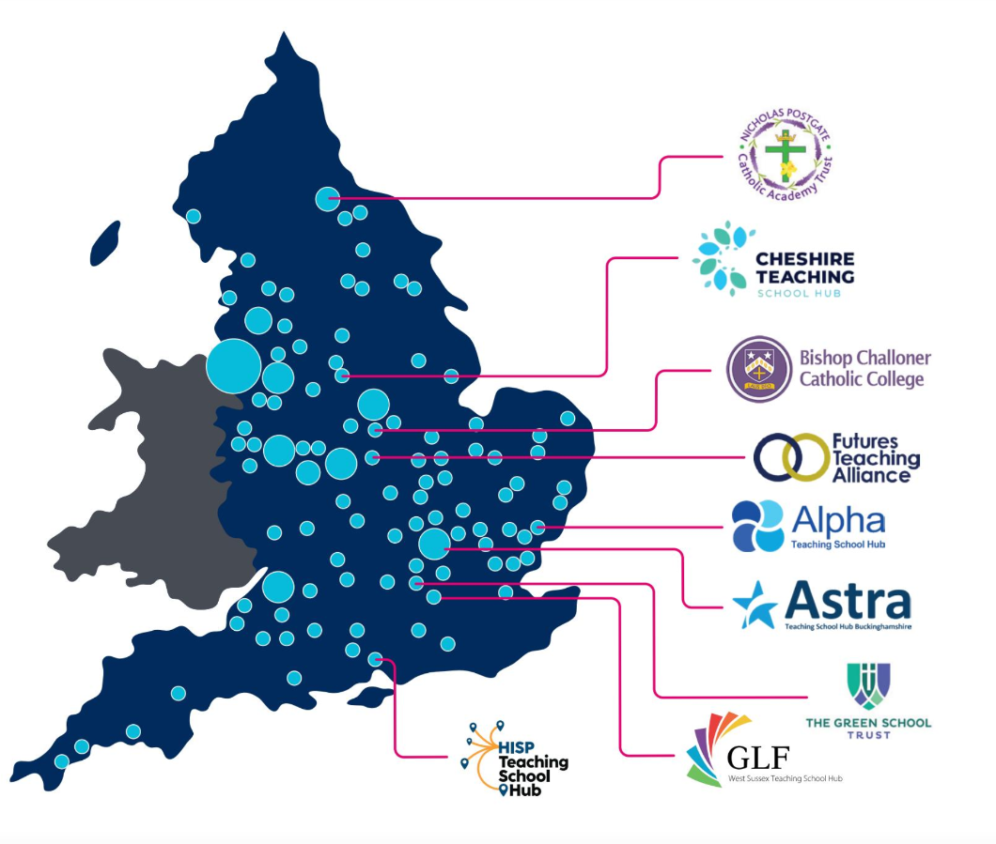
Local Groups, Nationwide Delivery
NPQs are delivered in partnership with TSHs, MATs and other schools groups across England.
Face-to-Face events are facilitated by local school leaders familiar with local challenges.
As most applications are received in July, we are unable to confirm viable groups until later in the year. However, we expect to be running groups in the same places we did in 2022. See 2022 Group Map here.
We have a growing number of international partners delivering NPQ Face-to-Face events, although the majority of international NPQs are delivered remotely. Contact us for your nearest international NPQ group.
Notes:
NPQs are delivered in partnership with TSHs, MATs and other schools groups across England.
Face-to-Face events are facilitated by local school leaders familiar with local challenges and contexts
You can see the approximate geographical spread of events and hubs on the map and whilst we can’t 100% guarantee those will be exactly the same for new applicants like yourselves, we do expect to run groups in the same places as previous cohorts
Growing number of international partners delivering NPQ Face-to-Face events: the majority of these are delivered remotely – use the contact details near the end of the slide deck if you’d like more information about NPQs in international settings

Slide 10
NPQLBC Perspectives
Notes:
Welcome Alison, Kirsty and Poppi,
Thank you for joining us today.
Please could I ask you Alison, to give us:
a brief bit of context about how the NPQs have supported participants in your partnership, and
your top highlights of the NPQLBC from your perspective please
How about you, Kirsty, – as a participant on the NPQ​LBC, what were your highlights?
Alison, as we saw in the earlier input, participants on the NPQLBC occupy a number of different roles and pathways – in your partnership, what were their roles and reach?
Poppi, what were the most impactful pieces of learning on the NPQLBC?
Alison, have there been any commonly arising questions from your NPQLBC participants?
Kirsty, what impact has the NPQ​LBC begun to have on you to date?
Poppi, what impact has the NPQ​LBC begun to have on you to date?
Potential discussion topics between partner, participants and Laura:
Examples of the roles and pathways participants on these programmes are in your partnership
Real and current case studies of best practice
Evidence
Myths and misconceptions
In- school performance coach
Up to date reflections of engagement
Commonly arising questions from participants?
No project!!!!!
Can enrol on any or all (not together!)
Thank you all – hugely insightful and brilliant to hear about the impact of the NPQLBC for different people involved in the programme

Slide 11
Funding – England only
Scholarships
From autumn 2022, the organisations eligible to access scholarships are:
state-funded schools
state-funded 16 to 19 organisations
independent special schools
virtual schools (local-authority-run organisations that support the education of children in care)
hospital schools not already included in other categories of eligible organisations
young offender institutions
Targeted support funding
The Department has updated the Targeted Support Fund offer for the 2023 to 2024 academic year to further incentivise state-funded schools and state-funded 16 to 19 educational settings in England to participate in NPQs.
For each teacher or leader they employ who takes an NPQ in the 2023 to 2024 academic year:
state-funded primary schools with one to 150 pupils will receive a grant payment of £800
state-funded primary schools with more than 150 pupils will receive a grant payment of £200
state-funded secondary schools and state-funded 16 to 19 educational settings with one to 600 pupils will receive a grant payment of £200
Notes:
Jamie Slide
Whilst there are no scholarships available for international participants (many of whom will be present), the fact that the DfE pays for scholarships should add to the prestige of the NPQs in the eyes of our international attendees

Slide 12
Next steps Contacts Q&A
NPQs can be viewed at www.bestpracticenet.co.uk/npq
International candidates should visit https://www.bestpracticenet.co.uk/international
Download qualification specifications
Discuss with school CPD lead, headteacher or relevant senior leaders
Contact us through the live chat function on our web site, enquiries@bestpracticenet.co.uk or phone 0117 920 94028
Apply sooner rather than later to avoid the last-minute rush!
Notes:
Next steps
Consider which programmes are best for you or for colleagues in school.
Straightforward slide – do utilise those contacts for ensuring you have all the information you need
Thank you to you all for joining and to everyone in the team who has contributed and will be getting those FAQs out as necessary
Get your applications before the Winter break in to guarantee spaces
Q&A – Tom to lead
Thank you and good evening
Q&A
Eligibility for funding and scholarships – Tom
Eligibility to apply
No hard cap on applications for BPN, but DfE does have a cap on the amount of money they can spend
Specialist before SL? Can go straight – depends on background and experience and demonstration of aspiration to SL as well as capacity to work across the school
SAT – unseen case study. However, remiss of us to not prepare you for that – choices of practice activities and FATs to prepare you
BPN-own assessment centre – arms length from us in delivery team in order to maintain ethics – then internal moderation, then national moderation
If don’t pass, can resubmit using a different case study SAT
Decision about gaining qualification also aligned to DfE’s compliance measure of 90% engagement (+ successful assessment SAT)
NPQH placement task has gone, however practice activities recommend H and EL do apply practice in a different context to their own
All progs are for aspirant colleagues – if aspiring for middle leadership, choose most appropriate specialist prog, if aspiring SL – apply to SL
Post links to website for eligibility and requirements
FAQ for outstanding questions - Tom

