Slide 1

Level 2 Early Years Practitioner and Level 3 Early Years Educator Apprenticeships

Slide 2
Programme Overview
Early Years Practitioner Level 2
The Level 2 Early Years Practitioner (EYP) Apprenticeship is ideal for individuals who are new to the early years sector as a way to start their early years career. The course supports apprentices to support learning and development of all young children within their care.
Early Years Practitioner Level 3
The Level 3 Early Years Educator (EYE) Apprenticeship is ideal for individuals to those who have completed their level 2 EYP or those who are experienced within the early years sector. This progression route enables apprentices to demonstrate effective pedagogy within their practice to promote children’s learning and development for the higher level of responsibility.

Slide 3
Programme Overview
Early Years Apprenticeships
It is an excellent progression route for practitioners to begin their journey with the level 2 Early Years Practitioner, to progress onto the Level 3 Early years educator to then begin to lead practice with the level 5 early years lead practitioner. These courses will progress and enhance their practice and knowledge.
The Level 2 Early Years Practitioner programme lasts for 12 months plus EPA.
The Level 3 Early Years Educator programme lasts for 16 months plus EPA

Slide 4
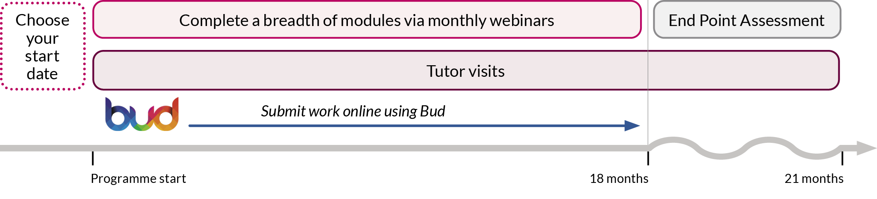
Key Facts
Monthly cohorts across level 2 and level 3 apprenticeships with the exception of August and December.
L2 EYE KSBs
29 Knowledge
25 Skills
7 Behaviours
L3 EYE KSBs
16 Knowledge
26 Skills
6 Behaviours

Slide 5
Our Delivery Plan
Blended Programme of face to face and online study
Additional study units on our VLE
Specialist 1-2-1 Early Years Tutor Support
Study Skills Support
Regular Reflections on Learning and Practice
Partnership working between BPN, the apprentice and the employer

Slide 6
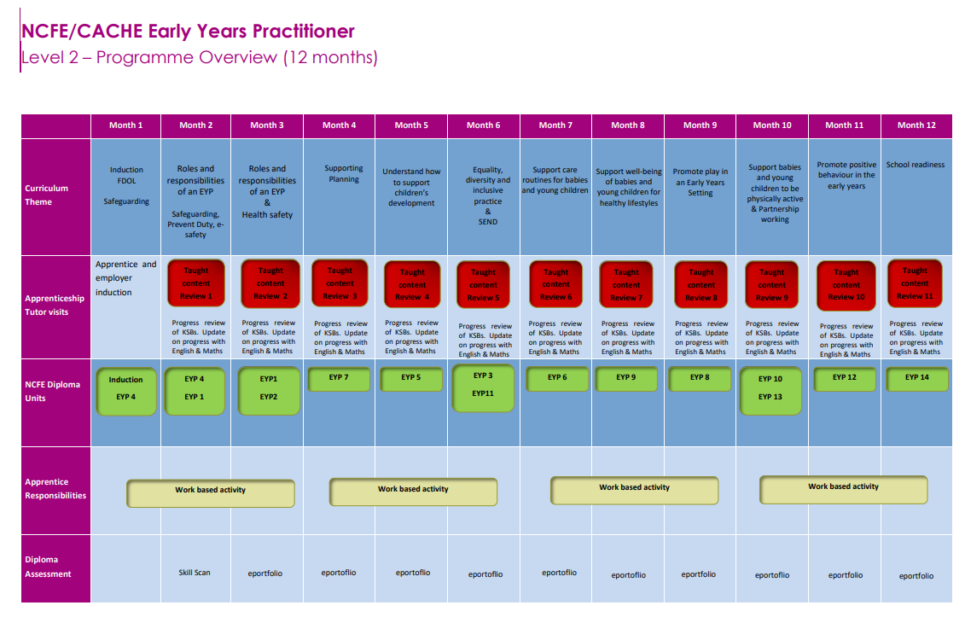

Slide 7
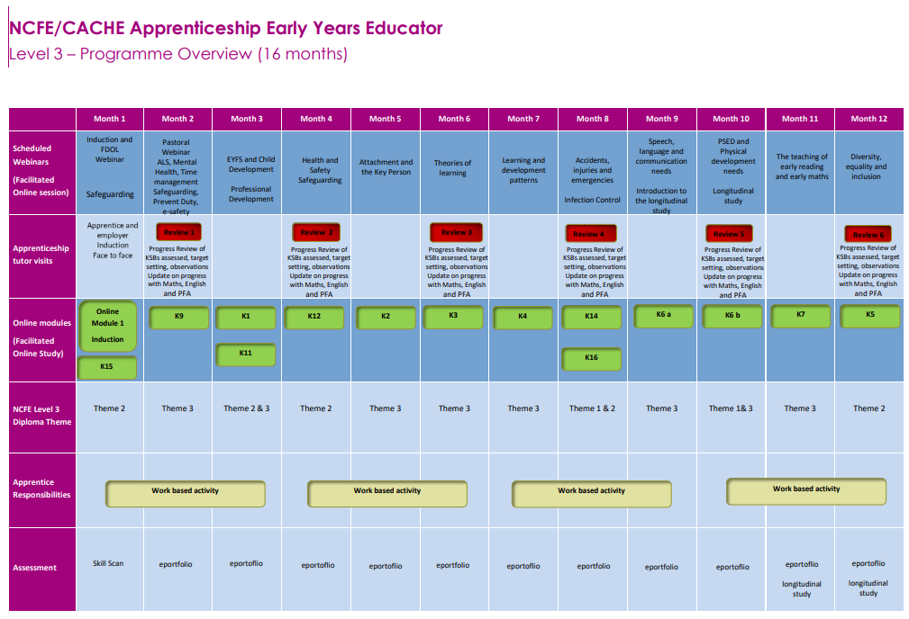

Slide 8

Our Curriculum
The curriculum encompasses the totality of apprentices’ learning experiences throughout their time on the programme.
We believe our curriculum is broad, balanced, relevant and forward thinking in order to meet the needs of the Early Years sector and raise outcomes for all children.
Immersion in the curriculum and the experiences it offers will prepare apprentices for their future career as Early Years Practitioners and Early Years Educators.
Vision: Our belief is that every child must have access to an excellent early years’ education, regardless of their background, and that every apprentice must be supported to be their best.

Slide 9
Our Curriculum Themes
Health and well-being
Legislation, frameworks and policy
Play, development and learning for school readiness
Professional development

Slide 10
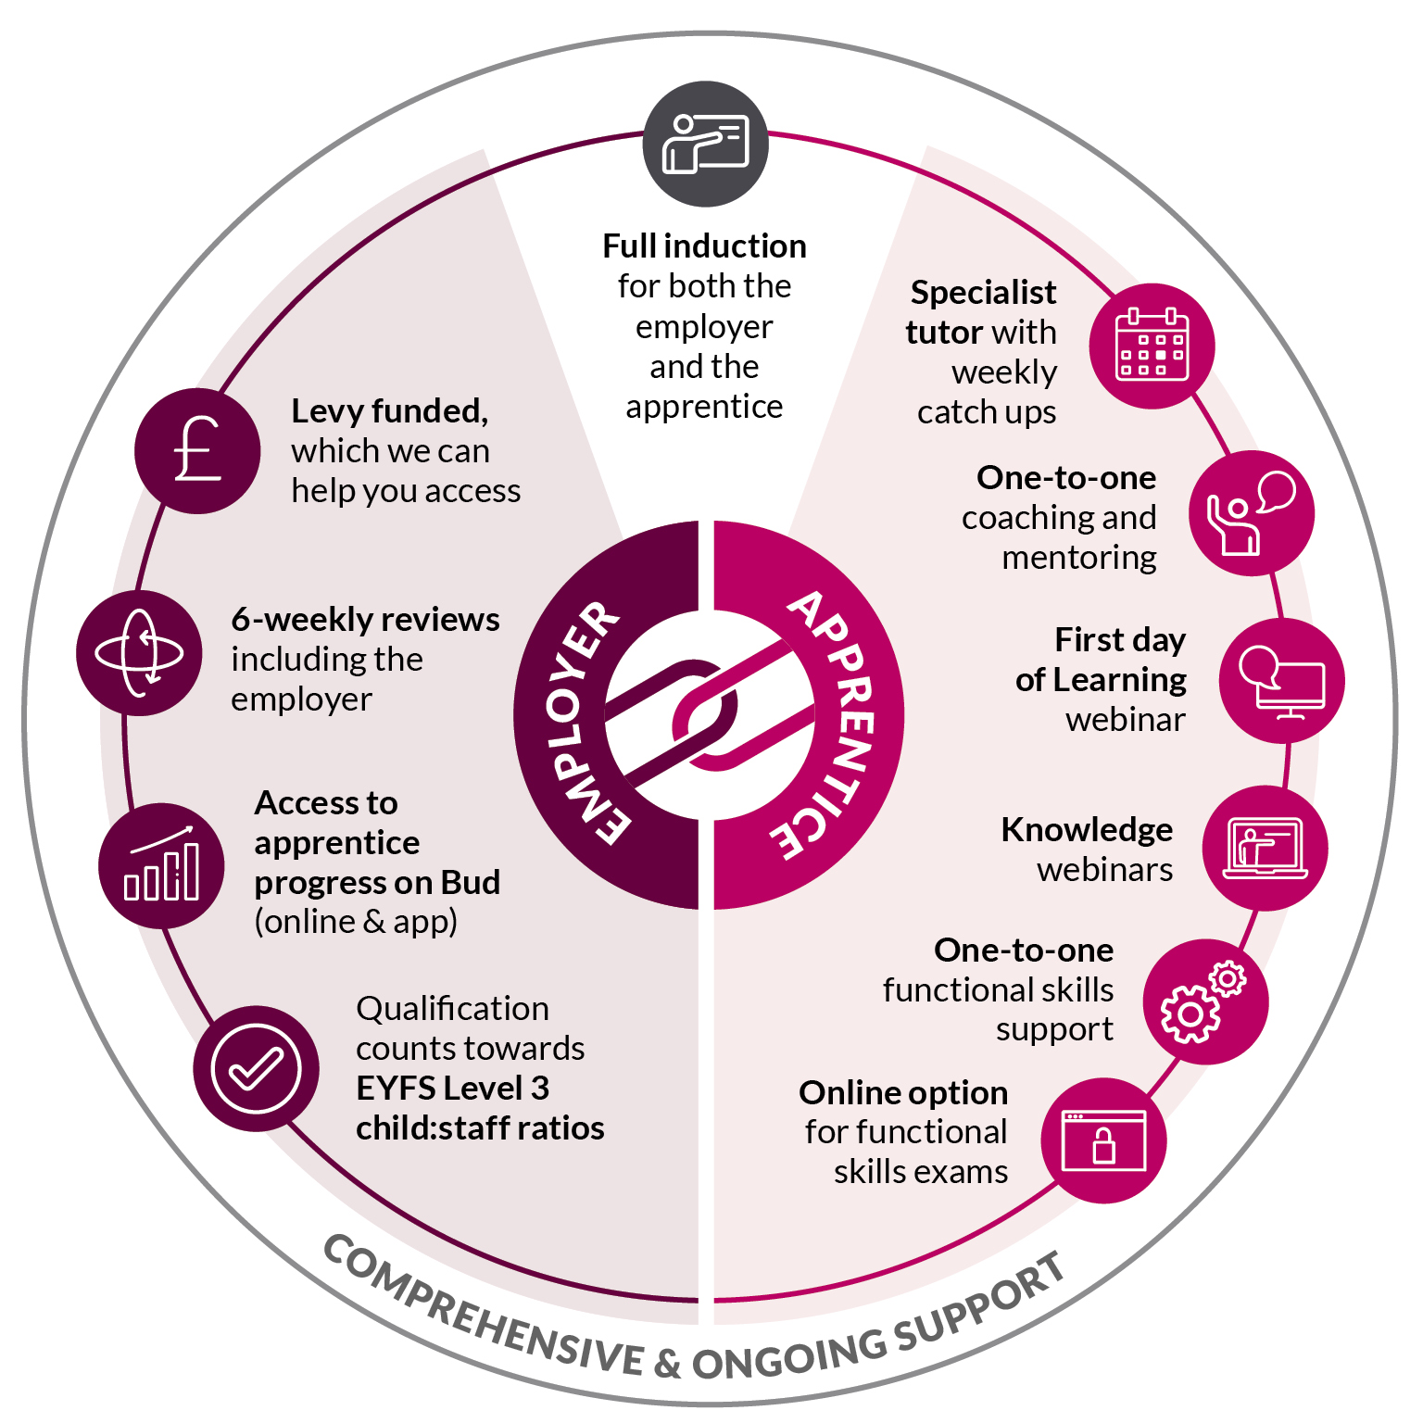
Why Choose Best Practice Network

Slide 11
End Point Assessment
Observation with Questions
An observation with questions involves an independent assessor observing and questioning an apprentice undertaking work, as part of their normal duties, in the workplace. This allows for a demonstration of the KSBs through naturally occurring evidence.
Professional Discussion underpinned by a Portfolio of Evidence
A professional discussion is a two-way discussion which involves both the independent assessor and the apprentice actively listening and participating in a formal conversation. The apprentice leads the discussion. The portfolio of evidence will typically contain 20 pieces of evidence. (workplace documentation)
Case Study with Presentation and Questioning
The case study report will be based on a case study that the apprentice has done with an individual child or group of children. The apprentice will scope out the case study and present it to the EPAO. The observations, analysis and preparation of the case study report and presentation will typically take 12 weeks. The Case study report will be 4000 words

Slide 12
Level 2 EYP End Point Assessment
Multiple choice knowledge test
Apprentices will take part in a multiple choice knowledge test as part of the end point assessment to demonstrate knowledge gained across the apprenticeship. The apprentice will have a maximum 60 minutes to undertake this test either computer based or paper based.
Professional Discussion underpinned by a Portfolio of Evidence
A professional discussion is a two-way discussion which involves both the independent assessor and the apprentice actively listening and participating in a formal conversation. The apprentice leads the discussion. The portfolio of evidence will typically contain 12 pieces of evidence. (workplace documentation)

Slide 13
Level 3 EYE End Point Assessment
Multiple choice knowledge test
Apprentices will take part in a multiple choice knowledge test as part of the end point assessment to demonstrate knowledge gained across the apprenticeship. The apprentice will have a maximum of 60 minutes to undertake this test either computer based or paper based.
Professional Discussion underpinned by a Portfolio of Evidence
A professional discussion is a two-way discussion which involves both the independent assessor and the apprentice actively listening and participating in a formal conversation. The apprentice leads the discussion. The portfolio of evidence will typically contain 10 - 12 pieces of evidence. (workplace documentation)

Slide 14
Early years teaching career pathway
EARLY YEARS TEACHER STATUS
1
2
3
4
5
LEVEL 2
LEVEL 3
LEVEL 5
DEGREE TOP UP
EYITT
Kick off a career in early years with our Early Years Practitioner Apprenticeship Level 2. After completion of the programme work in a range of early years setting, delivering Early Years Foundation Stage (EYFS).
Early years careers can be started or continued with Early Years Educator Apprenticeship Level 3. Apprentices will achieve an EYE qualification which has been approved to count towards the EYFS level 3 child: staff ratios.
The Early Years Lead Practitioner Apprenticeship Level 5 is ideal for highly skilled professionals who take an operational lead for the care, learning and development of all young children within their care.
Best Practice Network work closely with partners who deliver a 12-month top up programme, giving you a degree on completion and the qualification levels required to progress on to EYITT.
Finally, completing Early Years Initial Teacher Training awards Early Years Teacher Status (EYTS), and as the leading Early Years Initial Teacher Training (EYITT) provider in the country, we boast a 100% pass rate.
BEGIN CAREER

Slide 15

Any questions?

