Slide 1
National Professional Qualifications (NPQs)
An introduction to the new programmes
Notes:
Tom & Sally
Me to share screen and click for myself and Sally?
What time logging on?
Welcome
Laura Saunders – Lead Facilitator for Specialist NPQ Programmes
Sally Bishop – Lead Facilitator for NPQ Delivery Partnerships
Michelle Brew – Sales Director
Tom Bullock – Marketing Manager
Sufficient info and insight into BPN, what we do and the NPQ programmes for Feb 2022
Really excited to be working with you.

Slide 2
Best Practice Network & Outstanding Leaders Partnership
Every child able to benefit from an excellent education, regardless of background
Every education professional able to grow and give their best
School-led CPD provider since 2012
Proven infrastructure having supported 14,000+ participants over the last 3yrs
Deliver accredited CPD through a 160 strong national partner-led model
Provider of Apprenticeships, ECF, EYITT, HLTA, NASENCO & more
Exceeding DfE performance metrics
Dedicated and expert programme, participant and partner support teams
Inspire Learning
Strive for
Excellence
Work
Together
Act with Integrity
Known & Trusted | | | 98% Satisfaction
‘Exceptional’ Provision | | | 95% Pass Rate
2
Notes:
Sally
What we stand for – when choosing a provider like ours, it’s important to consider the values and approaches through which we operate
We’re here to get best leaders for all children, no matter where they are in the world – v important to us
The NPQ work supports your professional learning, through the prog and more importantly ensuring that you’re even better leaders at the end of the programme than you were at the beginning get the best for our children and schools
Inspire your learning, work together, act with integrity, and we want the best, so if you do too we do strive for that excellence
Data on slide – insight into width and depth – large PD provider, NPQs since 2012
Sally and myself are proud to be here this evening to share with you the next era of the NPQs in this reformed iteration

Slide 3
A clearer career pathway
Through the revised Initial Teacher Training Core Content Framework and the implementation of the Early Career Framework, the DfE are now supporting teachers in the first years of their career with a structured two-year induction into the profession.
The NPQs and New Headteacher Programme build on this foundation to provide continuous career pathways with training and support for teachers and leaders at all levels.
The revised suite of specialist and leadership NPQs will complete the golden thread from initial teacher training through to school leadership, rooting teacher and leader development in the best available evidence and collective wisdom of the profession.
Notes:
Sally
What’s fantastic about the NPQs is that they’ve become part of a very clear career pathway which starts with the trainee teacher and ITT, into the ECF and then onto NPQs with the specialist route programmes, and then senior leaders, headteachers and executive leaders – brings everything together, and provides a very clear pathway and golden thread that the government have been keen to create.
The NPQ is part of the bigger PD picture – more choices, opps and sense of direction to be better at what we do and to be able to make the difference to the young people we work with
Also underpinned by a much stronger evidence base – to apply and rehearse what you’re learning in practice, before then also challenging what you’re doing in practice.

Slide 4
NPQ programmes
NPQ Leading Teacher Development | For those who are, or aspire to, lead the development of other teachers
NPQ Leading Teaching | For those who are, or aspire to, lead teaching in a subject, year group, key stage or phase
NPQ Leading Behaviour & Culture | For those who are, or aspire to, lead behaviour and culture and/or pupil well-being
NPQ Senior Leadership | For those who are, or aspire to be, senior leaders leading across a school
NPQ Headship | For those who are, or aspire to be, headteachers leading across a whole school
NPQ Executive Leadership | For those who are, or aspire to be, executive leaders with responsibility across more than one school
So what’s changed?
NPQ content areas are threaded from the Early Career Framework
Specialist NPQs to support career pathway width and replace old middle leader NPQ
Assessed school-improvement projects have been replaced with practice-based formative and summative assessment tasks
Behaviours do not feature in DfE frameworks, however, we have embedded these throughout
Greater emphasis on practice-based activity and participant context
Notes:
Sally
There are 6 NPQ programmes (iteration just phasing out there are 4 programmes)
3 specialist programmes – LT, LTD, LBC – replacing the previous NPQML prog
12 months long, followed by assessment
3 other programmes – more familiar – but content and its delivery is different
Leadership programmes – 18 months + assessments
No longer 4000, 5000 or 2 lots of 4000 words – school improvement projects have gone
Application of learning in practice is now the focus and the final assessment follows the 12/18 months – case study scenario – responses need to be 1500 words – much lower expectation in terms of word count, but the requirement for completion is much tighter to fit in with the within an 8 day period, unseen
Pause here to hear from Kylie Spark about the power of NPQs

Slide 5
Kylie Spark
NPQs: A headteacher’s point of view
Notes:
Laura: Thank you Kylie – hugely insightful and brilliant to hear the rigour it’s given to colleagues you work with

Slide 6
Programmes overview
Specialist NPQs – NPQLT, NPQLTD & NPQLBC
Notes:
Laura
This slide gives you a timeline of the approximate hours the programme will take you in the 12/18 month period
3 stages to programme
Stage 1 – induction
Stage 2 – development stage, 3 main chunk of time
Stage 3 – Summative assessment stage
Induction
Underpinned by a needs analysis/skills audit – provides the critical platform for discussion with your coaches, mentors and facilitators. Critical – form basis for powerful conversation, feedback and direction for your choices and depth of study in your online course study
Vital that you take time with that at induction – ownership of pathway as you move through development stage and summative assessment stage, and that initial needs analysis approach will continue throughout the programme through your use of the LDR – the Leadership Development Record which will be a working document that records your new learning and progress.
This slide obviously focuses in on the specialist programmes
The next 3 slides offer the hours comprising the NPQSL, NPQH and NPQEL – Sally, do you want to add anything about the leadership route at this point?

Slide 7
Programmes overview
Leadership NPQs - NPQSL
Notes:
NPQSL – Sally

Slide 8
Programmes overview
Leadership NPQs - NPQH
Notes:
NPQH – Sally

Slide 9
Programmes overview
Leadership NPQs - NPQEL
Notes:
NPQEL – Sally

Slide 10
DfE Framework Content Areas | Leadership NPQs | Specialist NPQs
 |  | NPQLTD | NPQLBC | NPQLT
1. School Culture
2. Teaching
3. Curriculum & Assessment
4. Behaviour
5. Additional and Special Education Needs/Disabilities
6. Professional Development
7. Organisational Management
8. Implementation
9. Working in Partnership
10. Governance and accountability
Notes:
Laura
So, all NPQs are all based on these 10 content areas
They have been directed to us from the DfE
They appear in some form in the 6 NPQ frameworks
Leadership – you will need to cover all 10
Specialist – as you can see, each cover some of the content areas (LTD has 3 of the content areas, LBC has 5 and LT has 6) – we have to structure the programme to cover all of the relevant content areas indicated on this slide
This is why the audit is so crucial as you will all have varying degrees of knowledge about each in your contexts as some you will offer a greater level of expertise in from the beginning and some you’ll need to apply to your practice in greater depth through the course of the programme
Underpinning all of these content areas is a very strong and clear evidence base and resource list in each framework – specific school practice will be presented in your programmes to exemplify what they look like in practice, to bring them alive in given contexts and then challenge you through various different kinds of activities
This framework of content areas has guided the way the programmes have been structured and designed…

Slide 11
NPQ programme structure
access, relevance and choice for all
research evidence underpins pedagogy and content
practice-led learning to develop and embed expertise
clear professional journey aligned to DfE ‘golden thread’
Notes:
Laura
This is the structure
The way that the programmes ensure access, relevance and choice for all come back to the needs analysis – it’s critical, as well as the way you complete your application – it’s the first point of contact through which we will start to get to know you and will influence how we group you both online and in FTF events
You’ll see in the centre of the slide that those 4 top boxes, the key elements of all the programmes, are ‘repeated termly’ – the model is a cyclical rotation. So, when you’ve completed your induction, you’ll go to your first FTF event, then onto your online study, you’ll then apply your online study in the workplace through practice activities and formative assessment tasks, before being coached through feedback, support and challenge
We’ll look at these cycles in a little more detail shortly, but for now you’ll notice they are supported by enrichment activities for which learning communities are key part, which again comes back to the importance of your application so that we can place you with colleagues who you can learn alongside through levels of support and challenge that will develop you as leaders effectively – so give us that detail to ensure we get the best pathway for you.

Slide 12
NPQ cyclical learning pathway
Profile & Audit
Face-to-face
Online course
Formative Assessment Task
Profile Review
3 weekly Units
Complete a minimum of 3 formative activities from across units
Complete 1 overall learning reflection
Receive online mentor/coach feedback
Introduce key concepts & research from content area
Prepare participants for online study
Define focus of practice based activity
Review and refine needs & upload to coach / mentor
Skills audit
Develop professional profile
Coach / Mentor review
Refine Professional Profile
Coach / Mentor review
Select Formative Assessment Task and complete over 4-weeks
Coach / Mentor review and feedback
Notes:
Laura
Each cycle looks a bit like this: starting with you and your skills, followed by the build of your knowledge and understanding in a FTF event, then onto building that in further depth through the online course and then competing practice activities and formative assessment tasks before again reviewing.
This cyclical approach then repeats again, and builds cumulatively into the next cycle.
For the specialist programmes there is the induction cycle, followed by cycles 1, 2 and 3 and
for the NPQSL programme there is the induction cycle followed by cycles 1, 2, 3 and 4
For NPQH and NPQEL there are 5 cycles following the induction cycle
Each cycle feeds the next to build your knowledge and understanding.
Lots of reviews, discussions, feedback so that each element links through your own self-regulation and metacognition, as well as the support and challenge from colleagues supporting you and your progress.
You’ll notice the purple text draws out the relationship you will have either your coach/mentor (ISPC and online LM for those on specialist progs, and LPC for those on leadership progs). You will also all have facilitators to support you through the FTF events. These relationships are vital!
For those on specialist progs: The ISPCs will be nominated by you and your SLT and will be trained in coaching (the level of which will be dependent on their previous coaching experience)
Online Leadership Mentors provided by BPN
LPCs on leadership route also provided by BPN

Slide 13
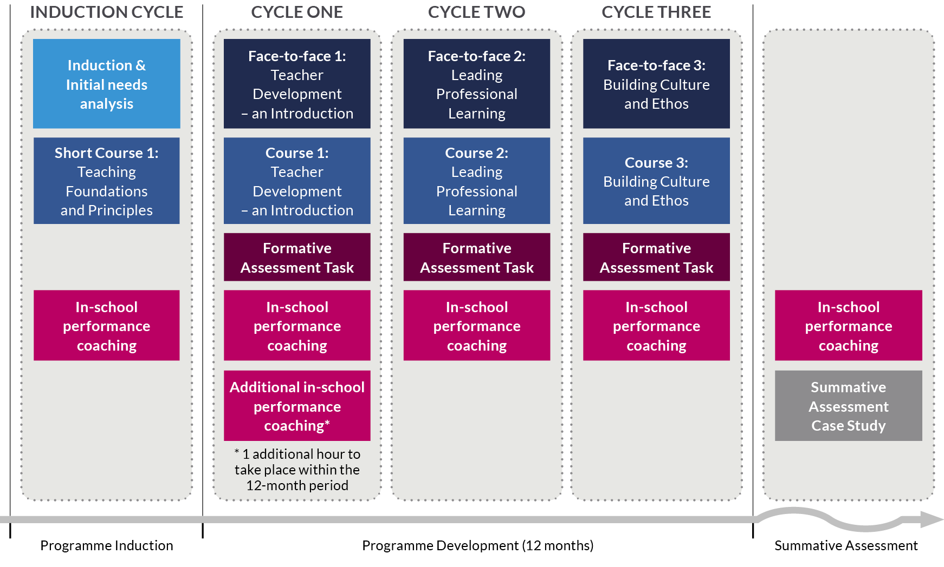
NPQ Programme
Specialist Programme
NPQLTD
12 Months
Notes:
Laura
So, we’ve gone from the overall pathway, to unpacking a given cycle – this is what the overarching delivery model of the specialist programme NPQLTD looks like. The following slides show the equivalent delivery model for the specialist programmes NPQLT and NPQLBC, and then the leadership programmes.
It illustrates the core body of knowledge – the content areas are all there across the cycles.
You will see in the Induction Cycle the short course ‘Teaching Foundations and Principles’ – this sets the scene for contextualising the programme for each of you, and reflecting on who each of you are in terms of your role and your leadership.
Crucially, this short course on the specialist route programmes is based on the ‘Teaching’ content area from the ECF, which again shows that golden thread of the career pathway for teachers and leaders in school. And this is to enable you to focus on your practice in relation to teaching to then build it in your leadership area within school through the rest of the programme, all based on great teaching.

Slide 14
NPQ Programme
Specialist Programme
NPQLT
12 Months
Notes:
Laura
NPQLT and NPQLBC follow exactly the same structure as NPQLTD, although have slightly different titles to represent the context of each programme.
I’ll give you a moment to look at the NPQLT delivery model…

Slide 15
NPQ Programme
Specialist Programme
NPQLBC
12 Months
Notes:
Laura
…and the NPQLBC delivery model.
When you come to decide which specialist programme to choose, if you haven’t already it’ll be really important to discuss this with your HT and consider together what your needs and aspirations are but also the needs and aspirations of the school or hub more widely.
There is a great deal more information on the DfE website about the specialist frameworks for you to get the detail about what each aims to achieve.
I’m going to pass over to Sally now to draw out any points of note and differences in delivery models for the leadership programmes.

Slide 16
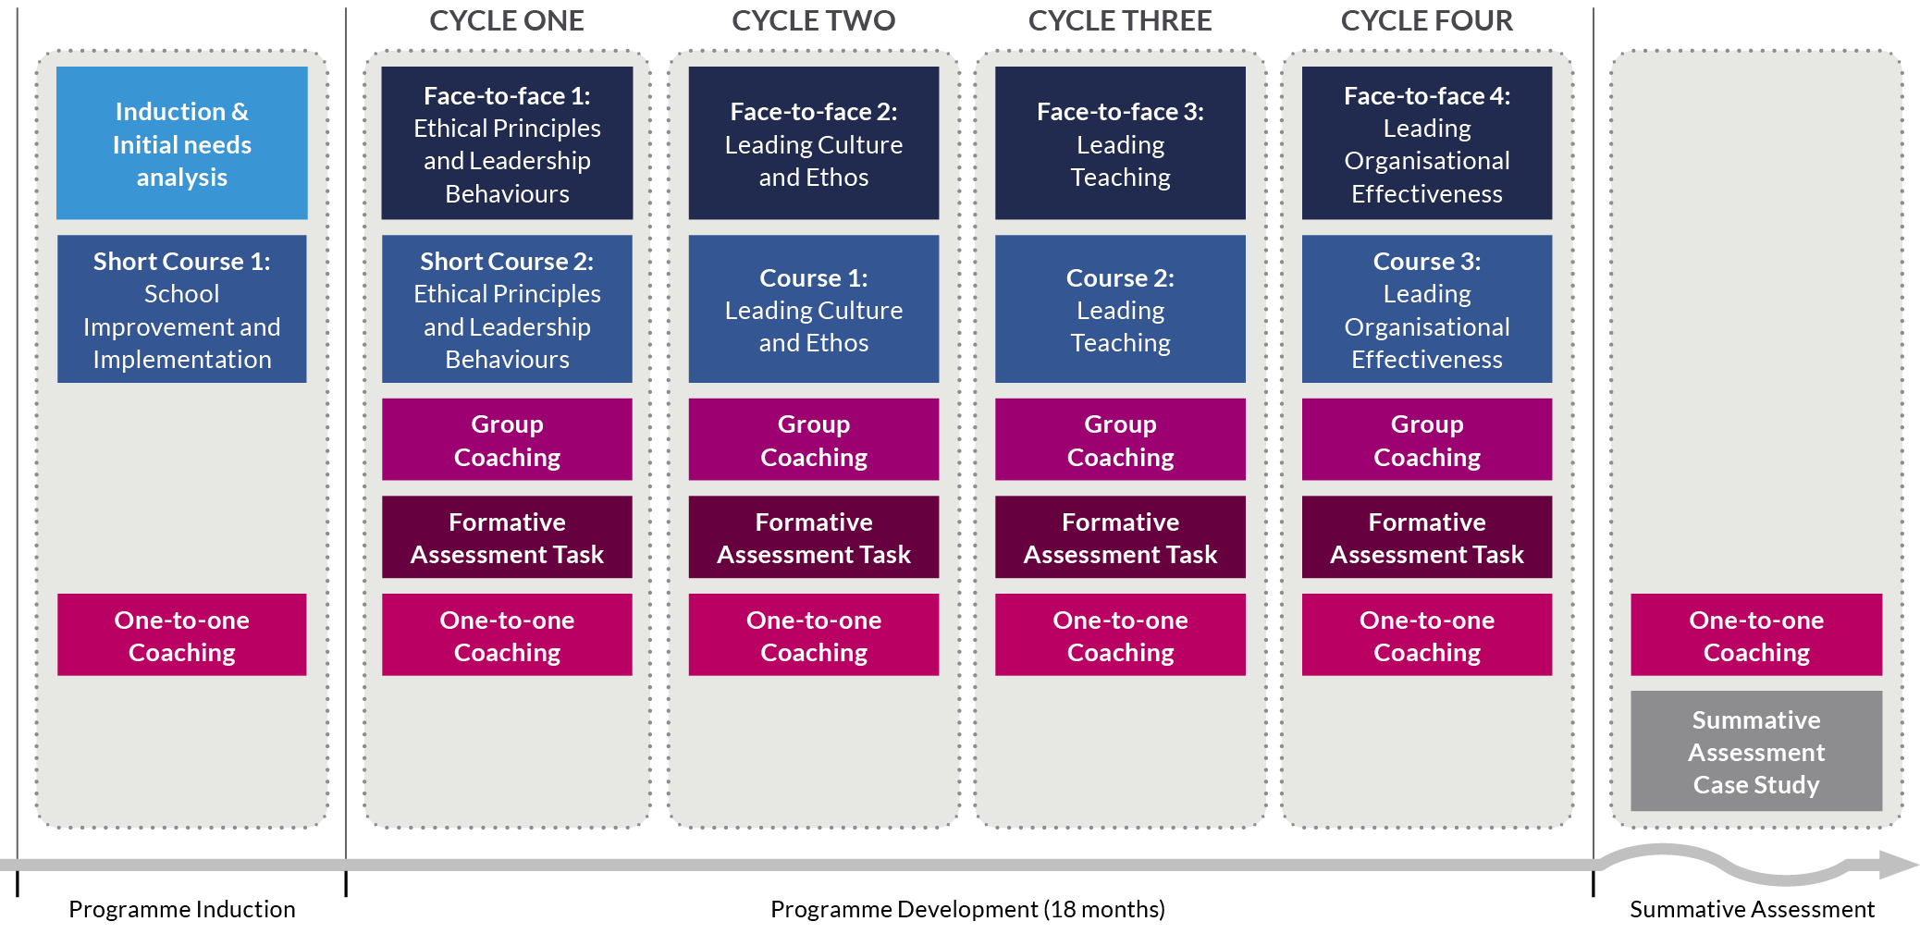
NPQ Programme
Leadership Programmes
NPQSL
18 Months
Notes:
Sally

Slide 17
NPQ Programme
Leadership Programmes
NPQH
18 Months
Notes:
Sally
New Headship programme

Slide 18
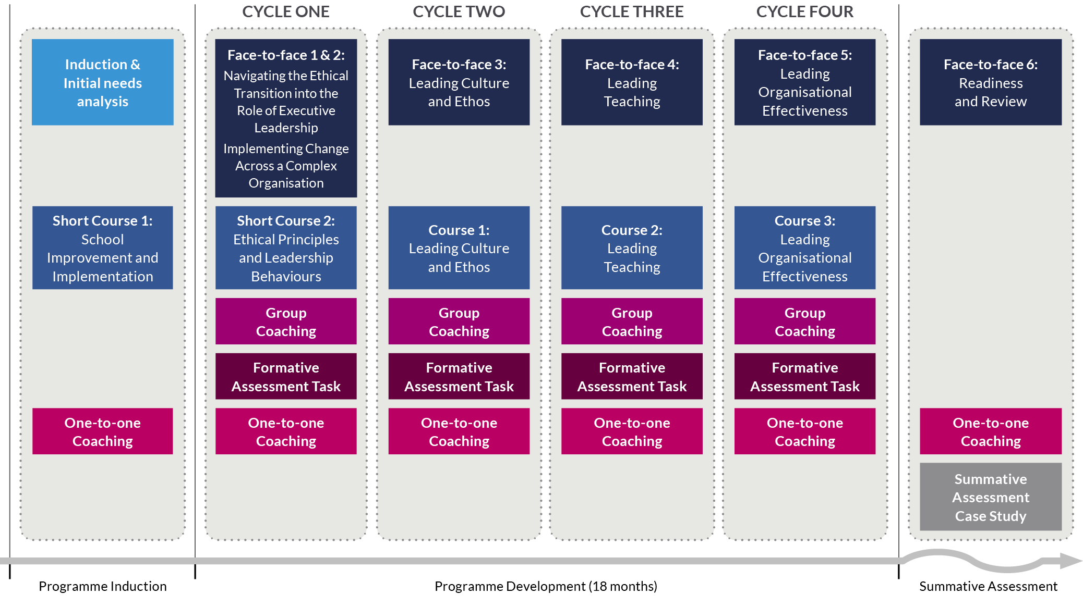
NPQ Programme
Leadership Programmes
NPQEL
18 Months
Notes:
Sally
We will share information about fees and funding etc shortly, and please do ensure you pop any questions into the Q&A
Before that though, we’re going to hand over to Lyndon Evans to give a participant’s perspective…

Slide 19
Programme fees (TBC)
Programme | Course fee | State funded schools
National Professional Qualification for Leading Teacher Development (NPQLTD) | £895 | Free to access
National Professional Qualification for Leading Behaviour and Culture (NPQLBC) | £895 | Free to access
National Professional Qualification for Leading Teaching (NPQLT) | £895 | Free to access
National Professional Qualification for Senior Leadership (NPQSL) | £1,135 | Free to access
National Professional Qualification for Headship (NPQH) | £1,975 | Free to access
National Professional Qualification for Executive Leadership (NPQEL) | £4,090 | Free to access
Notes:
(Sally to) Michelle
Handing over to my colleague Michelle Brew who is the BPN Sales Director now for initial information about fees and the signup process…

Slide 20
Apprenticeship funded routes
Apprenticeships are work-based training programmes for new and existing staff
All schools have access to Apprenticeship Levy funding either through their trust, LA or the ESFA’s co-investment scheme
Best Practice Network are a registered Apprenticeship Provider and have supported 800+ participants to access NPQs utilising levy funding
Our NPQSL & NPQEL have been mapped against Level 5 to Level 7 Apprenticeship Standards creating ‘dual-award’ programmes
The dual-award programmes provide participants the DfE’s NPQs inside the comprehensive wraparound support of an apprenticeship
Please join our NPQ Apprenticeship webinar on 8 December to find out more: https://us06web.zoom.us/webinar/register/WN_kn4Q-PNFQCOTxcZ0CcwUrw
Notes:
Michelle

Slide 21
Next steps
NPQs can be viewed at www.bestpracticenet.co.uk/npq or www.outstandingleaders.org/npq
Download qualification specifications
Discuss with school CPD lead or headteacher
Contact us through the live chat function on our web site, cpd@bestpracticenet.co.uk or phone 0117 920 9200
Apply sooner rather than later to avoid the last minute rush!
Notes:
Sally & Laura
Q&A – Tom to lead
Consider which programmes are best for you or for colleagues in school.
Straightforward slide – do utilise those contacts for ensuring you have all the information you need
Thank you to you all for joining and to everyone in the team who has contributed and will be getting those FAQs out as necessary.
Thank you and good evening.
Q&A
Eligibility for funding and scholarships – Michelle
Eligibility to apply – Sally? CAPS Team?
No hard cap on applications for BPN, but DfE does have a cap on the amount of money they can spend
Specialist before SL? Can go straight – depends on background and experience and demonstration of aspiration to SL as well as capacity to work across the school
SAT – unseen case study. However, remiss of us to not prepare you for that – choices of practice activities and FATs to prepare you
BPN-own assessment centre – arms length from us in delivery team in order to maintain ethics – then internal moderation, then national moderation
If don’t pass, can resubmit using a different case study SAT
Decision about gaining qualification also aligned to DfE’s compliance measure of 90% engagement (+ successful assessment SAT)
NPQH placement task has gone, however practice activities recommend H and EL do apply practice in a different context to their own
All progs are for aspirant colleagues – if aspiring for middle leadership, s=choose most appropriate specialist prog, if aspiring SL – apply to SL
Post links to website for eligibility and requirements

