Slide 1
Welcome to our Early Years Apprenticeship Taster session!

Slide 2
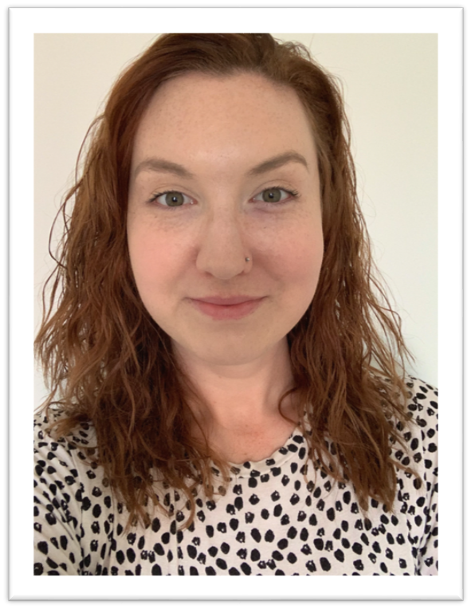
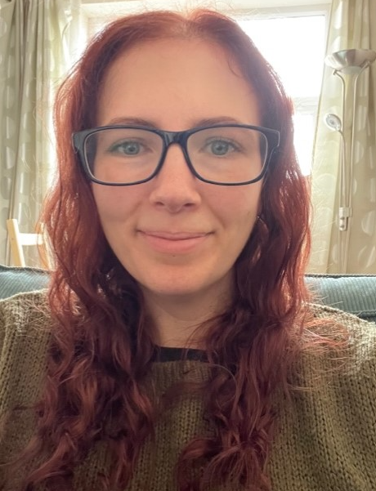
Introduction
Emma Reading
Curriculum Manager – Early Years, Teaching Assistant and Playworker
Charlotte Fowler
Early Years Virtual Classroom Tutor
Notes:
Introduce self – I will be leading the forum today.
Explain role and how today is the perfect opportunity to share your feedback on your apprenticeship programme.

Slide 3
What is an apprenticeship made up of?
Standard (Knowledge, skills and behaviours)
Maths and English functional skills
Off the job training
Gateway
End point assessment
Notes:
Apprenticeship elements:
Standard – knowledge, skills and behaviours to be met
Maths and English FS
Off the job training
Gateway – confirm ready for EPA
EPA

Slide 4
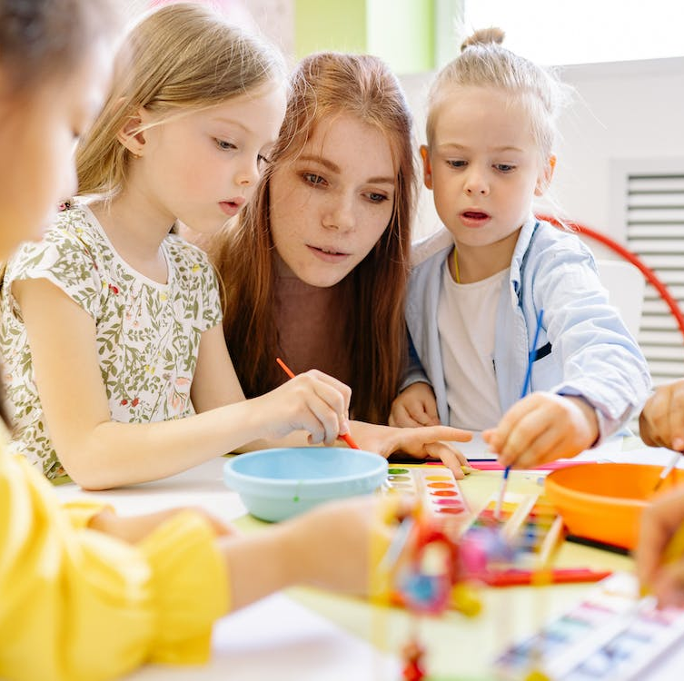
Overview of our early years level 2 and 3 apprenticeships
Early Years Practitioner Level 2 | Early Years Educator Level 3
13 month programme + 3 months EPA | 15 month programme + 3 months EPA
Functional skills maths and English level 1 | Functional skills maths and English level 2
Ideal for learners who are new to early years or not quite ready for level 3 | Supports in meeting level 3 ratios in an early years setting
Consists of 9 core modules | Consists of 11 core modules
End point assessment: Multiple choice question test Professional discussion underpinned by a portfolio of evidence | End point assessment: Observation and questioning Professional discussion underpinned by a portfolio of evidence

Slide 5

What are the benefits of our early years apprenticeships?
Support development of practitioners to help them to excel in their role
Allows apprentices to apply theoretical learning into practice in the workplace
Provides a fully recognised qualification in line with the EYFS/ratio requirements
Offers a route into higher education whilst working and gaining practical experience
Develops confidence, communication skills and supports wider learning
Opportunity to gain a fully funded qualification (95% government funded)

Slide 6
Early years apprenticeships – progression route
Early Years Practitioner level 2 apprenticeship
Early Years Educator level 3 apprenticeship
Early Years Lead Practitioner level 5 apprenticeship
Top up degree in early years
Early Years Initial Teacher Training (EYITT)
Notes:
We are partnered with a university who we can recommend for an online top up degree however we advise enquiring directly with universities on their entry requirements.

Slide 7
Our Delivery Plan
Blended programme of face to face and online study
Specialist 1-2-1 Tutor Support
BPN boost – personal development, career information advice and guidance and welfare programme
Regular reflections on learning and practice
Partnership working between BPN, the apprentice and the employer
Progress reviews every 6 weeks

Slide 8
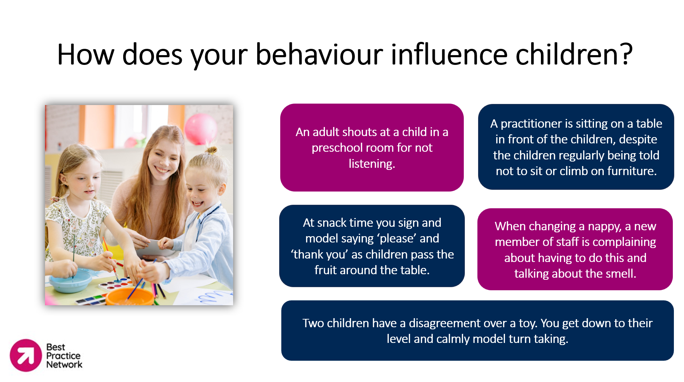
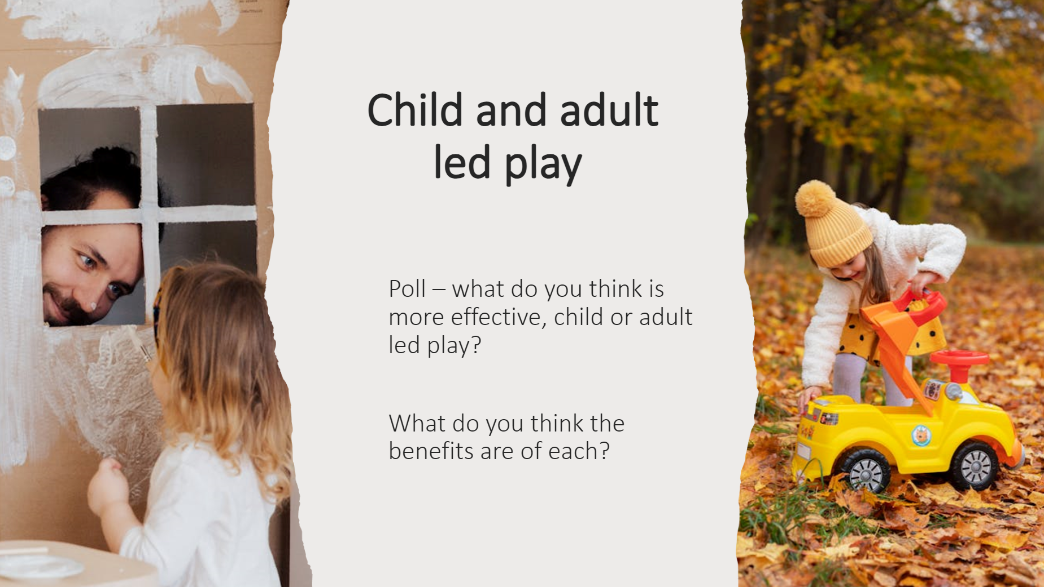
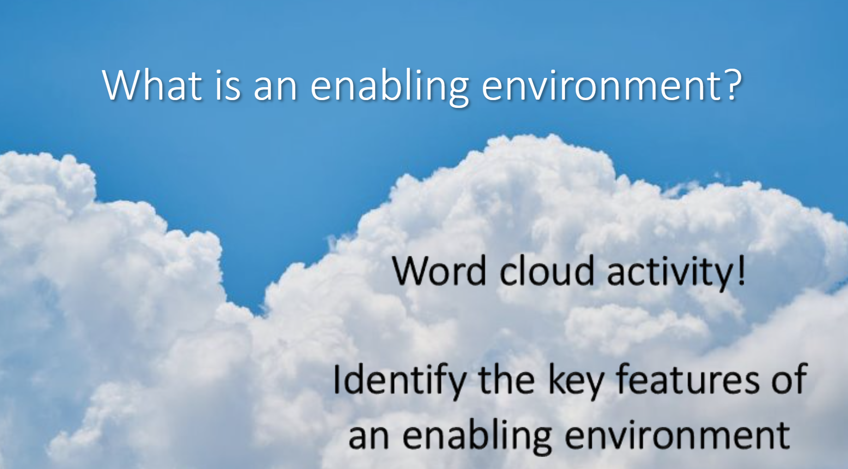
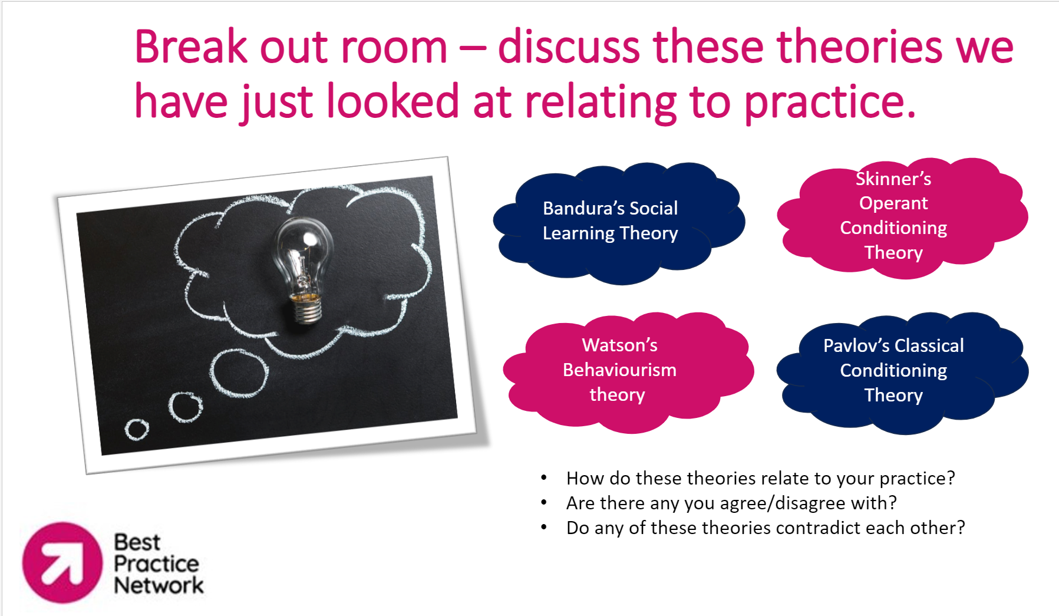
Virtual classrooms
Each month, learners will attend online group virtual classroom sessions.
These are designed to be interactive and engaging sessions.

Slide 9

Code of conduct and expectations
Mobile phones off/
silent
Camera on
Active listening
Join in
Be respectful of others
Mutual Respect and Tolerance
Rule of Law
Individual Liberty
Democracy
Notes:
Tutor to explain these are our usual code of conduct and expectations for sessions. For this session highlight that participants can get as involved as they feel comfortable with.

Slide 10
The aims of today are:
Identify the different areas of development and how children learn
Identify factors that can influence development and explain how children can be supported

Slide 11

How confident are you with child development?
1 | 2 | 3 | 4 | 5 | 6 | 7 | 8 | 9 | 10
Notes:
Ask learners to think of the aims of this session when rating themselves. How confident are they with child development – 1 being the lowest and 10 being the highest?
Tutor to highlight how this links in with the learner skill scan – 8 would be that they would be confident to pass EPA right now on this topic.
Learners to message their numbers in the chat box. Learners to reflect on this score at the end of the webinar and how it has improved.

Slide 12

What is child development?
Child development refers to the physical, cognitive, emotional, and social growth and changes that occur in children from the moment they are born until they reach adolescence.
You are observing two toddlers, Oliver and Isabella, who are both 18 months old. As you watch them, you notice that they are exhibiting different patterns of development.
Oliver, at 18 months, has already mastered the skill of walking confidently and is beginning to explore running. He can also use simple words to communicate his needs, like saying "mummy" or "teddy."
Isabella, also 18 months old, is not yet walking independently. Instead, she crawls and pulls herself up on furniture. However, she surprises everyone by saying several words clearly and using them in simple sentences. Isabella's development seems to be happening at a faster rate in terms of language skills compared to her gross motor skills.
What is the difference between the sequence and rate of development? Can this be identified in the scenario?
Notes:
Ask learners – can they define child development?
Child development refers to the physical, cognitive, emotional, and social growth and changes that occur in children from the moment they are born until they reach adolescence. It involves how children learn to walk, talk, think, and interact with others.
Ask learners to read and discuss the scenario:
You are observing two toddlers, Oliver and Isabella, who are both 18 months old. They are playing together in a daycare setting. As you watch them, you notice that they are exhibiting different patterns of development.
Oliver, at 18 months, has already mastered the skill of walking confidently and is beginning to explore running. He can also use simple words to communicate his needs, like saying "mummy" or "teddy." Oliver seems to be following a typical developmental sequence, where one skill builds upon another in a predictable order.
On the other hand, Isabella, also 18 months old, is not yet walking independently. Instead, she crawls and pulls herself up on furniture. However, she surprises everyone by saying several words clearly and using them in simple sentences. Isabella's development seems to be happening at a faster rate in terms of language skills compared to her gross motor skills.
Ask learners: What is the difference between the sequence and rate of development, and can this be identified in the scenario?
In this scenario, the sequence of development refers to the order in which different skills are acquired, while the rate of development relates to the speed at which these skills are mastered. Oliver follows a typical sequence by first mastering walking before advancing to running, while Isabella's rate of development is faster in terms of language skills compared to her gross motor skills. This scenario illustrates how children can exhibit varying sequences and rates of development across different domains.
Sequence: The expected pattern of developmental milestones.
Rate: The pace which the child achieves these milestones.
The children typically will develop in an expected sequence e.g. walking before running however may develop in some areas before others. The rate of development is different for every child.

Slide 13

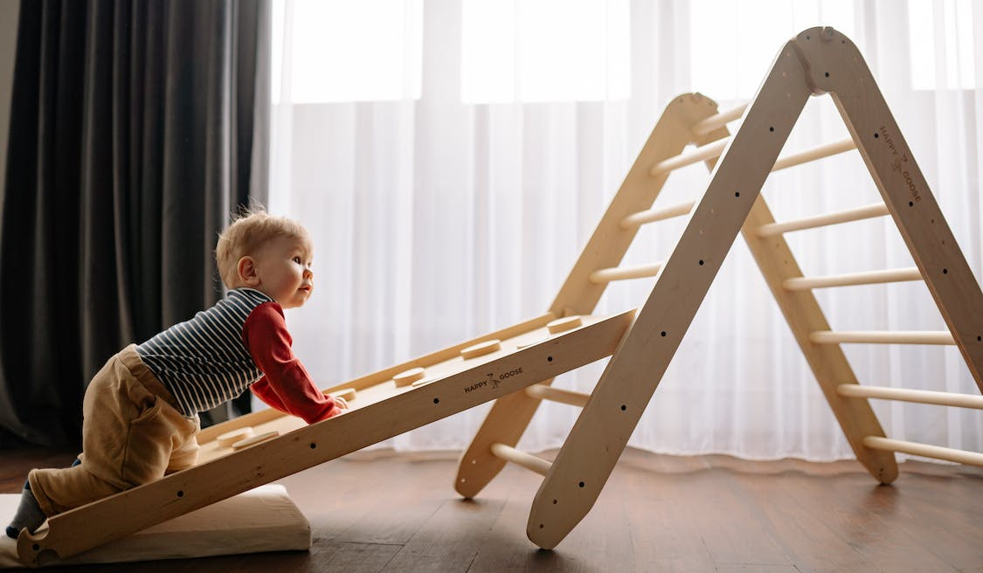
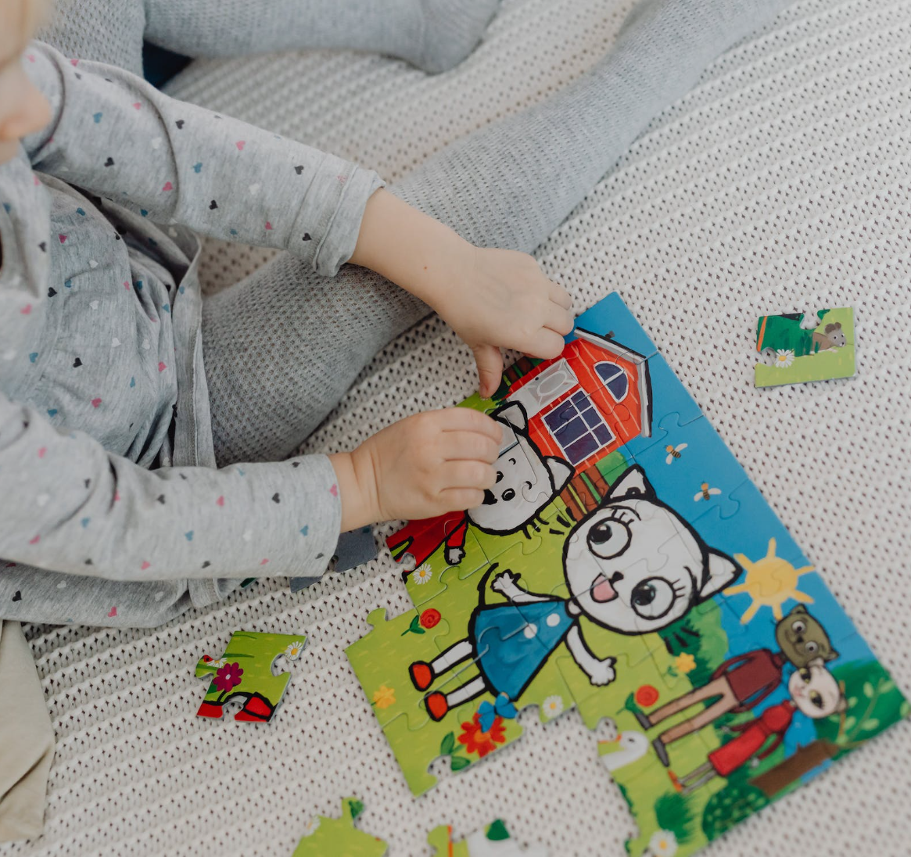

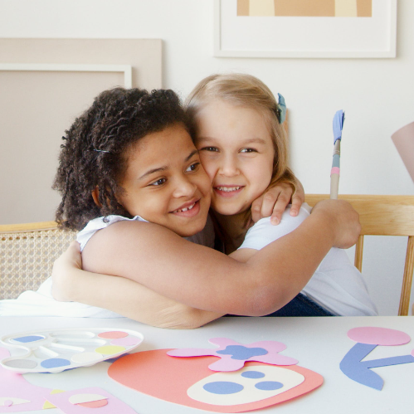


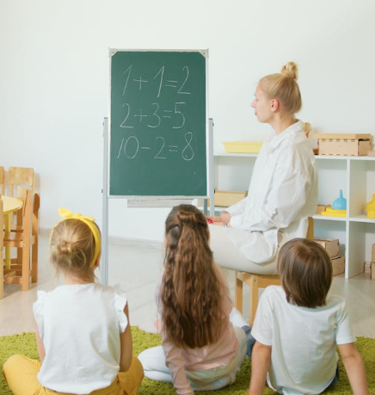

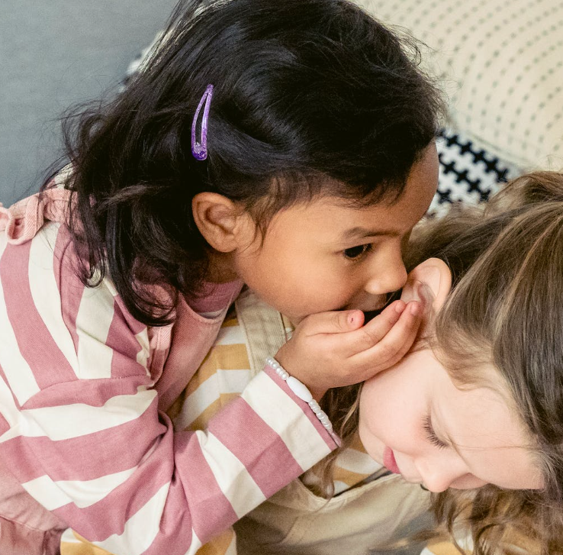
Can you identify the main areas of learning and development?
Notes:
Ask learners – can they identify the areas of learning and development? Ask learners to identify as many as they can. The images are there as a prompt – there is one representing each key area.
From the images:
Speech language and communication (child talking to another child)
Social (2 children hugging)
Emotional (child having a tantrum)
Neurological development (brain and lightbulb)
Physical (baby on climbing equipment)
Physiological/Biological – (child measuring height)
Literacy (child reading)
Numeracy (children and teacher looking at maths questions)
Cognitive (Puzzle)
Tutor to use Padlet – set up in advance, get learners to add comments under each area identifying the sorts of milestones they would expect to see children achieving within each area. Tutor to facilitate discussion around the different contributions and use as an example to discuss when different milestones may be achieved.
Explain in our usual full session we will go into depth with activities focusing on each area.

Slide 14
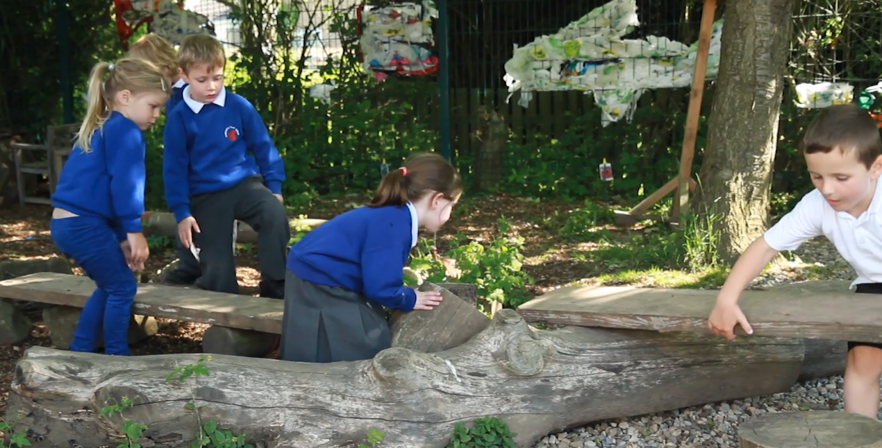
How do children learn?
What are the characteristics of effective teaching and learning?
Playing and exploring – children investigate and experience things and ‘have a go’
Active learning – children concentrate and keep on trying if they encounter difficulties, and enjoy achievements
Creating and thinking critically – children have and develop their own ideas, make links between ideas and develop strategies for doing things.
https://www.sirenfilms.co.uk/library/creating-and-thinking-critically-choosing-ways-to-do-things/
Notes:
Ask learners – how do children learn? What do children need to be able to learn? To then discuss further with learners.
Children learn and develop through a mix of inherited traits, family interactions, and environmental factors.
Social interactions and relationships with peers and caregivers, along with positive role models, play crucial roles in emotional and social development.
Cognitive stimulation, including educational opportunities, language-rich environments, and engaging activities, supports intellectual growth.
Physical play, sports, and recreational activities contribute to the development of motor skills, coordination, and overall physical health.
Providing emotional support, teaching emotional regulation, and establishing routines contribute to a child's mental and emotional well-being.
Experiential learning through hands-on activities and encouraging curiosity helps children explore and understand their surroundings.
Supporting and engaging children in activities relevant to their interests.
Ask learners – what do they know about the characteristics of effective teaching and learning? These come from the EYFS and are more related to how children learn than what they learn. Ask learners – are they aware of what any of these are?
Then to reveal on screen. Ask learners can they give examples of how they have seen learners demonstrating these characteristics? Tutor to try and get learners to give specific examples and to also share their own examples.
To then watch the video (to click on link on the screen to take you to sirenfilms to watch this). Ask learners to watch and make notes and then discuss. How are the characteristics of effective learning demonstrated in this video?
The clip relates specifically to creating and thinking critically – ask learners if they have spotted any others too.

Slide 15
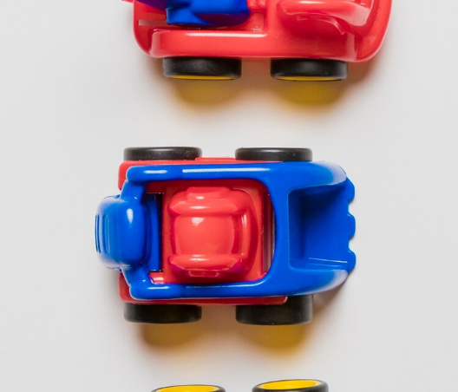
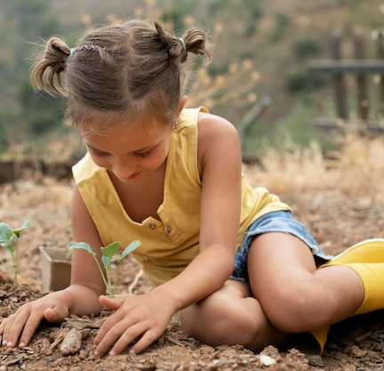
Supporting development scenarios
Scenario 1: Archie is 20-month-old who is interested in cars. He is a very active child and was walking from 12 months old however his language is still limited. How could you plan to support his development?
Scenario 2: Freya is 3 years old and attends your preschool setting. She loves outdoor play and is usually found outside at every possible opportunity playing in the mud kitchen and engaging in physical play. You have noticed through observing her that she does not often engage in literacy or mathematics activities and you are keen to support her development in these areas.
Notes:
Ask learners – how would they support the development of the children in the scenarios? Tutor to highlight the importance of knowing children well, planning based on their interests and individual developmental needs.
Scenario 1 - Supporting Archie's Development:
Given Archie's strong interest in cars and his active nature, planning activities that integrate movement and language development can be beneficial. For example, setting up a car-themed obstacle course with tunnels and ramps can encourage him to walk, climb, and explore actively. Incorporating verbal cues and introducing simple words related to cars during play can help boost his language skills. Additionally, incorporating picture books or flashcards featuring cars can be a playful way to introduce more vocabulary and stimulate language development.
Scenario 2 - Supporting Freya's Literacy and Mathematics Development:
To support Freya's development in literacy and mathematics, integrating these concepts into her outdoor play, aligning with her love for the mud kitchen and physical activities, is crucial. For instance, introducing numeracy through activities like counting natural objects or incorporating math concepts into her mud kitchen play, such as measuring ingredients, can be effective. To enhance literacy, introducing storytelling sessions during outdoor play, encouraging her to engage in imaginative play that involves creating narratives, can be beneficial. Providing literacy-rich materials in the outdoor area, such as chalkboards or weather-resistant books, can further encourage her interest in these areas while capitalizing on her love for outdoor play.

Slide 16

How are you feeling?
Add an emoji into the chat box to show how you are feeling about the information you have been taught so far.
Is there anything you need more support with?
Notes:
Ask learners – how are they feeling at the moment, relating to the information that has been taught?
Add an emoji to the chat to show how they are feeling, e.g. happy with the information they have received, confused, etc. Ask learners to note down in chat if there is anything they need more support with.

Slide 17
What factors can you name that could impact on a child’s development?
Special educational needs/ disability
Family relationships
Health conditions
Cultural influences
English as an additional language
Poverty
Genetics
Brain development
Nutrition
Education
Peer relationships
Notes:
Ask learners – how many factors can they name that can impact on children’s development? Explain to learners that this can be anything that can have a positive or negative influence on how a child learns and develops.
Reveal the examples on the screen. Have learners thought of any more?
Explain we are going to look at the difference between biological and environmental factors. Ask learners what they think the difference is?
Biological factors, are influenced by genetics and physiological processes. Environmental factors are external factors that influence development.
Use a whiteboard or Padlet for learners to sort factors into biological/environmental factors.

Slide 18

Scenarios
Scenario 1: Sophie, a 3-year-old, recently joined the nursery. English is not spoken at home, and Sophie primarily communicates in her native language. Discuss how Sophie’s bilingual background may influence her language development and social interactions with peers.
Scenario 2: James, a 2-year-old, comes from a low-income family with limited access to educational resources and extracurricular activities. Discuss how the lack of resources at home may affect James's cognitive development and social interactions with peers.
Scenario 3: Emily, a 4-year-old, has been diagnosed with Autism Spectrum Disorder. Discuss how this may impact on Emily’s learning and development and her time at nursery.
Notes:
Break out rooms – learners to discuss the scenarios. Tutor to ask learners to consider how the different scenarios may impact on a child’s development and strategies that could be used to discuss. Then to come together and discuss as a whole group.
Scenario 1: Discussion Points:
How might Sophie’s bilingualism impact her ability to communicate and form connections with other children?
What strategies can be employed to support Sophie’s language development while respecting and celebrating her cultural background?
How can the nursery create an environment that values diversity?
Scenario 2 Discussion Points:
In what ways can the nursery provide additional resources and experiences to support James's cognitive development?
How can educators create an inclusive environment that minimises the impact?
What collaborative efforts with the community or external organizations can be explored to enhance opportunities for children like James?
Scenario 3 discussion points:
What specific challenges might Emily face in social interactions and communication within the nursery setting?
How can educators tailor activities and provide support to meet Emily's unique needs?
In what ways can Emily's peers learn about and understand autism to foster a supportive and inclusive environment?
Tutor to discuss the roles of other professionals, e.g. SENCO, when discussing the scenarios, also to find out if any learner has an interest in this role? Signpost to Boost for useful links.

Slide 19
How are you feeling?
Add an emoji into the chat box to show how you are feeling about the information you have been taught so far.
Is there anything you need more support with?
Notes:
Ask learners – how are they feeling at the moment, relating to the information that has been taught?
Add an emoji to the chat to show how they are feeling, e.g. happy with the information they have received, confused, etc. Ask learners to note down in chat if there is anything they need more support with.

Slide 20

Quiz time!
What is cognitive development?
What is neurological development?
Can you name any of the characteristics of effective teaching and learning?
Can you name 3 factors which may influence development?
Notes:
Quiz – ask learners each question one at a time. Learners to type their answers into the chat box and to use ‘chat-pause-send’ to send the tutor their answers all at once for each question.

Slide 21
How confident are you now with child development?
1 | 2 | 3 | 4 | 5 | 6 | 7 | 8 | 9 | 10
Notes:
Ask learners how confident they are now with child development? To put their number in the chat box and compare. How have they progressed? Encourage learners to note down this score for when they update their skill scan.
Test learners against objectives:
Explain how children learn and develop
Identify the different areas of development
Explain the characteristics of effective learning and EYFS areas
Identify factors that can influence development and explain how children can be supported

Slide 22


Next steps
Any questions?
Apply on our website!
EYP Level 2: https://www.bestpracticenet.co.uk/ey-practitioner-l2-apprenticeship
EYE level 3: https://www.bestpracticenet.co.uk/eye-level3-apprenticeship
Contact us: enquiries@bestpracticenet.co.uk or call 0117 920 9428
Notes:
To also discuss how we can help if they don’t currently have a workplace.

