Slide 1
The benefits of Apprenticeship programmes for school leaders​
Spring 2022

Slide 2

What is an apprenticeship?
Apprenticeships are work-based training programmes that are designed to help employers train people for specific job roles
Apprentices get a paying job with valuable training while they work towards a nationally recognised apprenticeship standard
An apprenticeship can be for new or existing staff
Best Practice Network currently offers 5 Apprenticeship programmes
Notes:
TC

Slide 3
School Leaders qualifications
with Best Practice Network
Best Practice Network identified the need for Schools to have access to high quality apprenticeship programmes that mapped against the existing, highly regarded NPQ programmes, that could be funded from the apprenticeship levy.
Two dual qualification programmes were launched in September 2020;
Operations/Departmental Manager Level 5 Apprenticeship with NPQSL
Operations/Departmental Manager Level 5 Apprenticeship with NPQML
Over 700 apprentices already enrolled
New programmes carefully written with collaboration from existing partners and industry experts and mapping and marketing checked and approved by the DfE
Executive Leaders Apprentice Programme https://www.bestpracticenet.co.uk/leader-apprenticeship-npqel
Headteacher Apprentice Programme https://www.bestpracticenet.co.uk/headteacher-apprenticeship-npqh
Senior Leaders Apprentice Programme https://www.bestpracticenet.co.uk/leader-apprenticeship-npqsl
Notes:
TC

Slide 4
Why a Leaders Apprenticeship with us?​
Programmes written specifically for the schools’ sector​
Over 750 school leaders currently on our programmes​
Mapping of apprenticeship programmes with three new NPQ’s scrutinised and agreed by the DfE​
Industry experienced Apprenticeship Tutors giving one to one support​
Additional learning and training compared to standalone NPQ’s​
Utilise levy funding, co-investment or levy transfer https://www.gov.uk/guidance/receive-a-levy-transfer-from-another-business-to-fund-an-apprenticeship​
Notes:
TC

Slide 5
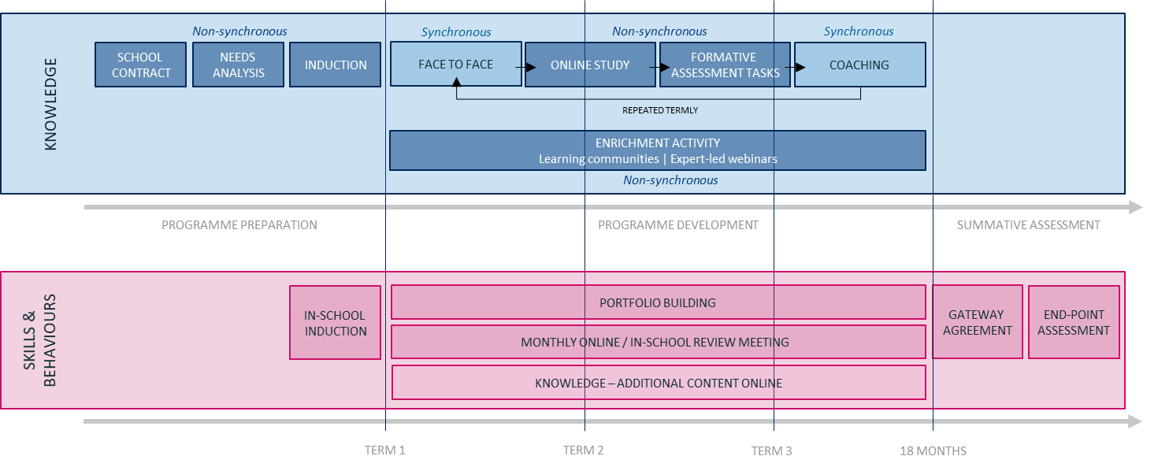
Why do a dual qualification?
Get the best of both an Apprenticeship and an NPQ
Notes:
TC

Slide 6
Apprenticeships with NPQ’s overview
 | Standalone NPQ’s |  |  |  | Apprenticeships including NPQEL, NPQSL & NPQH
 | Specialist NPQs | NPQSL | NPQH | NPQEL | Senior Leader Apprentice Programme with NPQSL (Level 5 Operations or Departmental Manager apprenticeship ) Executive Leader Apprentice Programme with NPQEL (Level 7 Senior Leader apprenticeship ) Headteacher Apprentice Programme with NPQH (Level 7 Senior Leader apprenticeship)
 | 12 month qualification plus 3 months Summative Assessment | 18 month qualification plus 3 months Summative Assessment |  |  | Senior Leader including NPQSL Headteacher including NPQH Executive Leader including NPQEL 18 months on programme plus 5 months (max) End Point Assessment
Preparation & induction | 6 hours |  |  |  | 4 hours
Face-to-face events | 3 days (18hrs) | 4 days (24hrs) | 5 days (30hrs) | 6 days (36hrs) | FDOL webinars 6 hrs ( Safeguarding, H&S, BV’s, Prevent, C&M, e.safety) (19 x 4-weekly reviews (alternate formal/informal) = 19hrs)* 1:1 support/delivery = 19 hrs observations = 7 hrs
Online course study | 34 hours | 38 hours |  |  | 1.5 hours every 2 months = 12hrs
Performance coaching | 6 hours | 10 hours |  |  | N/A
FATs (In-school Practice Application of learning) | 18 hours | 20 hours | 28 hours | 34 hours | Portfolio building 24 hours for all programmes
Summative assessment stage | Case Study scenario – 1500 words minimum – 8 hours |  |  |  | Senior Leader – Project Proposal – 6 hours Headship – Strategic Business Proposal – 8 hours Executive Leader – Strategic Business Proposal – 8 hours
Total learning and assessment hours | 90 | 106 | 120 | 132 | Senior Leader = 78 additional = 184 hours Executive Leader = 80 additional = 212 hours Headteacher = 80 additional = 200 hours
* Four-weekly reviews not included in OTJT hours
Notes:
AW

Slide 7
Executive Leader Apprentice Programme overview
Level 7 Senior Leader Apprenticeship
Length of programme
Planned for 18 months plus typically 5 months for End Point Assessment
Qualifications included
Nationally recognised Level 7 revised Senior Leader apprenticeship Standard accredited by industry regulatory bodies.
The DfE accredited National professional Qualification in Executive Leadership (NPQEL).
Aligns with recognition by:
Chartered Management Institute – Chartered Manager or Chartered Fellow • The Institute of Leadership and Management - Fellow
Notes:
AW

Slide 8
Senior Leader Apprentice Programme overview
Level 5 ODM Apprenticeship
Length of programme
Planned for 18 months plus typically 5 months for End Point Assessment
Qualifications included
Nationally recognised Level 5 revised Operations or Departmental Manager Apprenticeship standard accredited by industry regulatory bodies.
The DfE accredited National professional Qualification in Senior Leadership (NPQSL).
Aligns with recognition by:
Chartered Management Institute - would be eligible to become a Full Member of the Chartered Management Institute ● The Institute of Leadership and Management - would be eligible to become a Full Member of The Institute of Leadership and Management
Notes:
AW

Slide 9
On programme
Initial induction webinar for both apprentices and employers/mentors, employers recorded
Initial induction webinar for the NPQ with full course explanation and timetable of events
Initial one to one induction/introduction with Apprenticeship Tutor in the workplace (covid allowing) for both employers and apprentices;
  Introduction to e-portfolio system ‘Bud’
  On programme initial skills scan/discussion on ILP
  Further checks and discussions on Safeguarding, Health and Safety, Cyber security, British Values and Prevent
Four weekly reviews (formal/informal)/ 8 weekly face to face tri-partite reviews and observations/professional discussions to support on skills and behaviours, portfolio and additional knowledge delivery
Follow same NPQ programme of learning as all other NPQ standalone candidates
Continuous Portfolio building to include evidence from NPQ learning and skills
Follow English and maths programme of learning if required (Level 2 Functional Skills)
Gateway tripartite (employer/apprentice/training provider) meeting on completion of portfolio of evidence and all other apprenticeship criteria met
End Point Assessment activities within 5 months post Gateway
Notes:
AW

Slide 10
Off the job training (OTJT)
Off the job training is time during the apprenticeship that is allocated to enable apprentices to achieve their apprenticeship outside of their normal day to day working duties
20% OTJT is mandatory and must be evidenced
It must be paid time within the apprentice’s working hours. It must be new learning.
The amount is based on the number of hours the apprentice is contracted for
The purpose is to further develop their knowledge and skills linked to their apprenticeship
How will it be recorded?
The 20% has been planned for every activity on Bud and will automatically be set for each apprentice. It will be checked/adjusted and confirmed at the end of each activity.
Notes:
AW - Examples of these include:
Teaching of theory. For example: lectures, training day attendance
Shadowing or being mentored
Practical training
Training to use a piece of equipment that you need to master to do your job
Simulated exercises and role play activity
Attendance at competitions
Webinars and online learning
Learning support provided by the employer
Visiting the employer’s other sites and properties
Industry visits or visiting other companies or suppliers
Writing assessments and assignments
In-house training programmes and CPD – where it links directly to the apprenticeship
Standard Professional and informal discussions anytime anywhere
Revision sessions for End Point Assessment

Slide 11
Summary
 | NPQSL standalone | Senior Leaders Apprentice Programme | NPQEL standalone | Executive Leaders Apprentice Programme | NPQH standalone | Headship Apprentice Programme
Learning hours delivered | 106 | 184 | 132 | 212 | 120 | 200
Qualifications gained | NPQSL | ODM Level 5 Apprenticeship NQPSL | NPQEL | Senior Leaders L7 Apprenticeship NPQEL | NPQH | Senior Leaders L7 Apprenticeship NPQH
Cost | £1140 | £7000 (levy) | £4095 | £14000 (levy) | £1980 | £14000 (levy)

Slide 12
NPQ programmes
NPQ Leading Teacher Development | For those who are, or aspire to, lead the development of other teachers
NPQ Leading Teaching | For those who are, or aspire to, lead teaching in a subject, year group, key stage or phase
NPQ Leading Behaviour & Culture | For those who are, or aspire to, lead behaviour and culture and/or pupil well-being
NPQ Senior Leadership | For those who are, or aspire to be, senior leaders leading across a school
NPQ Headship | For those who are, or aspire to be, headteachers leading across a whole school
NPQ Executive Leadership | For those who are, or aspire to be, executive leaders with responsibility across more than one school
So what’s changed?
NPQ content areas are threaded from the Early Career Framework
Specialist NPQs to support career pathway width and replace old middle leader NPQ
Assessed school-improvement projects have been replaced with practice-based formative and summative assessment tasks
Behaviours do not feature in DfE frameworks, however, we have embedded these throughout
Greater emphasis on practice-based activity and participant context
Notes:
Sally
There are 6 NPQ programmes (iteration just phasing out there are 4 programmes)
3 specialist programmes – LT, LTD, LBC – replacing the previous NPQML prog
12 months long, followed by assessment
3 other programmes – more familiar – but content and its delivery is different
Leadership programmes – 18 months + assessments
No longer 4000, 5000 or 2 lots of 4000 words – school improvement projects have gone
Application of learning in practice is now the focus and the final assessment follows the 12/18 months – case study scenario – responses need to be 1500 words – much lower expectation in terms of word count, but the requirement for completion is much tighter to fit in with the within an 8 day period, unseen
Pause here to hear from Kylie Spark about the power of NPQs

Slide 13
NPQ cyclical learning pathway
Profile & Audit
Face-to-face
Online course
Formative Assessment Task
Profile Review
3 weekly Units
Complete a minimum of 3 formative activities from across units
Complete 1 overall learning reflection
Receive online mentor/coach feedback
Introduce key concepts & research from content area
Prepare participants for online study
Define focus of practice based activity
Review and refine needs & upload to coach / mentor
Skills audit
Develop professional profile
Coach / Mentor review
Refine Professional Profile
Coach / Mentor review
Select Formative Assessment Task and complete over 4-weeks
Coach / Mentor review and feedback
Notes:
Laura
Each cycle looks a bit like this: starting with you and your skills, followed by the build of your knowledge and understanding in a FTF event, then onto building that in further depth through the online course and then competing practice activities and formative assessment tasks before again reviewing.
This cyclical approach then repeats again, and builds cumulatively into the next cycle.
For the specialist programmes there is the induction cycle, followed by cycles 1, 2 and 3 and
for the NPQSL programme there is the induction cycle followed by cycles 1, 2, 3 and 4
For NPQH and NPQEL there are 5 cycles following the induction cycle
Each cycle feeds the next to build your knowledge and understanding.
Lots of reviews, discussions, feedback so that each element links through your own self-regulation and metacognition, as well as the support and challenge from colleagues supporting you and your progress.
You’ll notice the purple text draws out the relationship you will have either your coach/mentor (ISPC and online LM for those on specialist progs, and LPC for those on leadership progs). You will also all have facilitators to support you through the FTF events. These relationships are vital!
For those on specialist progs: The ISPCs will be nominated by you and your SLT and will be trained in coaching (the level of which will be dependent on their previous coaching experience)
Online Leadership Mentors provided by BPN
LPCs on leadership route also provided by BPN

Slide 14
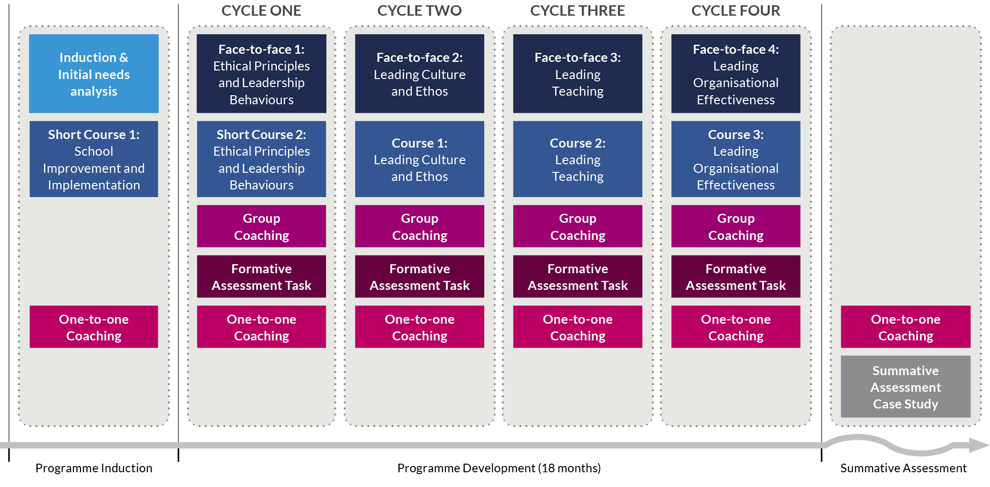
NPQ Programme
Leadership Programmes
NPQSL
18 Months
Notes:
Sally

Slide 15
NPQ Programme
Leadership Programmes
NPQH
18 Months
Notes:
Sally
New Headship programme

Slide 16
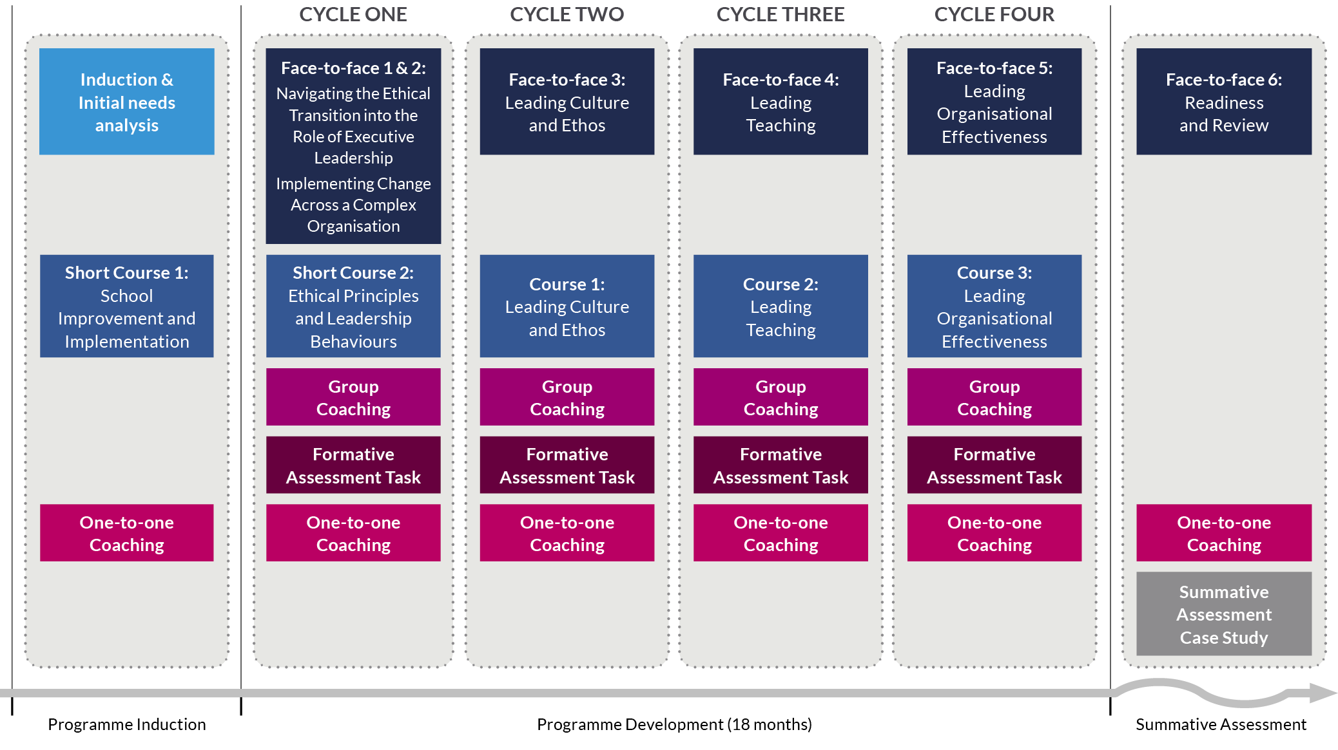
NPQ Programme
Leadership Programmes
NPQEL
18 Months
Notes:
Sally
We will share information about fees and funding etc shortly, and please do ensure you pop any questions into the Q&A
Before that though, we’re going to hand over to Lyndon Evans to give a participant’s perspective…

Slide 17
Apprenticeship Tutors
Notes:
Chris

Slide 18
The view from an apprentice;
Eleanor Morris

Slide 19




Application and onboarding
Apprentice completes application;
Executive Leaders Apprentice Programme https://www.bestpracticenet.co.uk/leader-apprenticeship-npqel
Headteacher Apprentice Programme https://www.bestpracticenet.co.uk/headteacher-apprenticeship-npqh
Senior Leaders Apprentice Programme https://www.bestpracticenet.co.uk/leader-apprenticeship-npqsl
(Includes Initial skills scan to check sufficient new learning is required)
Best Practice Network checks eligibility for NPQ programme and completes funding checks and set up on the Apprenticeship Service
Application passes to Bud system and applicant requested to complete short maths and English initial assessment.
Applicant invited to onboarding meeting and prepares proof of; maths and English at level 2, ID, ALS needs, change of name (if relevant)
Apprenticeship Agreement, Commitment Statement and Finance Agreements sent electronically for signature
Notes:
MB

Slide 20
What is the apprenticeship levy, am I eligible and how do I access it?
The levy is paid by large employers with a wage bill of over £3 million. These employers pay 0.5% of their total annual pay bill into the levy. Most state-maintained schools and multi-academy trusts pay into the levy and all schools can access the levy to fund apprenticeship training. Dependent upon the individual school, levy funding can be accessed through their trust, their local authority, or the ESFA via the co-investment scheme.
Best Practice Network provide support to candidates and their employers in order to access this funding.
Notes:
MB

Slide 21

Thank you and any questions?
Contact us
enquiries@bestpracticenet.co.uk
T +44 (0)117 440 7844

