Slide 1
Specialist National Professional Qualifications (NPQs)
An introduction to the specialist NPQLT programme (Leading Teaching)

Slide 2
NPQ programmes: what changed in 2020?
So what’s changed?
Through the revised Initial Teacher Training Core Content Framework and the implementation of the Early Career Framework, the DfE are now supporting teachers in the first years of their career with a structured two-year induction into the profession
NPQ content areas are threaded from the Early Career Framework
The NPQs and New Headteacher Programme build on this foundation to provide continuous career pathways with training and support for teachers and leaders at all levels (with Teaching content from the ECF in all of the specialist NPQs)
The revised suite of specialist and leadership NPQs will complete the golden thread from initial teacher training through to school leadership, rooting teacher and leader development in the best available evidence and collective wisdom of the profession

Slide 3
NPQ programmes: what changed in 2020?
Specialist NPQs
Leadership NPQs
NPQ Leading Teaching (NPQLT) | For those who lead, or aspire to lead teaching in a subject, year group, key stage or phase. 12 months.
NPQ Leading Teacher Development (NPQLTD) | For those who lead, or aspire to lead the development of other teachers. 12 months.
NPQ Leading Behaviour & Culture (NPQLBC) | For those who lead, or aspire to lead behaviour and culture and/or pupil well-being. 12 months.
NPQ Leading Literacy (NPQLL) | For teachers who lead, or aspire to lead literacy across a school, year group, key stage or phase. 15 months.
NPQ Early Years Leadership (NPQEYL) | For those who lead, or aspire to lead, nurseries or childminders with leadership responsibilities. 21 months.
NPQ Senior Leadership (NPQSL) | For those who are, or aspire to be, senior leaders leading across a school. 18 months.
NPQ Headship (NPQH) | For those who are, or aspire to be, headteachers leading across a whole school. 18 months.
NPQ Executive Leadership (NPQEL) | For those who are, or aspire to be, executive leaders with responsibility across more than one school. 18 months.
So what’s changed?
Specialist NPQs support career pathway width and replace old NPQML
Assessed school-improvement projects have been replaced with practice-based formative and summative assessment tasks
Behaviours do not feature in DfE frameworks, however, BPN have embedded these throughout
Greater emphasis on practice-based activity and participant context – practice activities, in-school performance coach
Domain-specific evidence base

Slide 4
Specialist NPQ programmes: assessment
12 month programme followed by summative assessment task
Case study (will only cover content which is referred to in the NPQ Content Framework)
SAT will allow participants to demonstrate understanding of the DfE’s NPQ Framework ‘learn that’ statements and how they can successfully apply this new knowledge through the ‘learn how to’ statements
The SAT will have its own mark scheme and marks will be awarded for both 'learn that' and 'learn how to' statements
The SAT submission is 1,500 words: participants receive the unseen case study at the start of an eight-day assessment window and submit their response by midnight of the eighth day
This SAT window falls 12-15 months after the start of the programme.
Participants are required to meet 90%+ engagement as well as a successful SAT to pass their programme

Slide 5
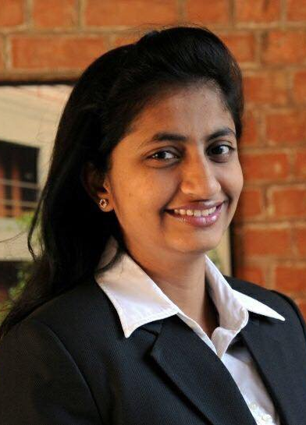
Specialist NPQ programmes: who can enrol
NPQ Leading Teaching | For those who lead, or aspire to lead teaching in a subject, year group, key stage or phase

Slide 6
Programmes overview: content areas
DfE Framework Content Areas: Specialist NPQs (NPQLT, NPQLTD, NPQLBC) | NPQLT | NPQLTD | NPQLBC
 | 1. Teaching | 1. Teaching | Teaching
 | 2. School Culture |  | 2. School Culture
 | 3. How Pupils Learn | 2. Designing Effective Professional Development | 3. Enabling Conditions for Good Behaviour
 | 4. Subject and Curriculum | 3. Delivering Effective Professional Development | 4. Complex Behavioural Needs
 | 5. Classroom Practice
 | 6. Adaptive Teaching
 | 7. Assessment
 | 8. Professional Development |  | 5. Professional Development
 | 9. Implementation | 4. Implementation | 6. Implementation
DfE Framework Content Areas: Leadership NPQs (NPQSL, NPQH, NPQEL)
1. School Culture
2. Teaching
3. Curriculum & Assessment
4. Behaviour
5. Additional and Special Education Needs/Disabilities
6. Professional Development
7. Organisational Management
8. Implementation
9. Working in Partnership
10. Governance and accountability

Slide 7
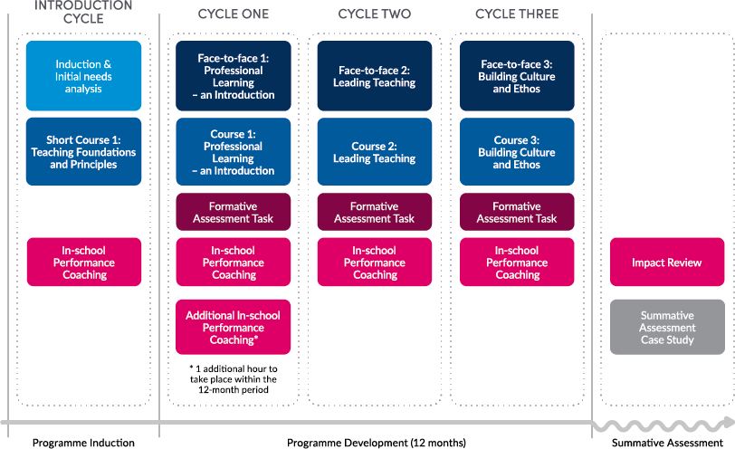
Programme Structure
Recommended
Recommended

Slide 8
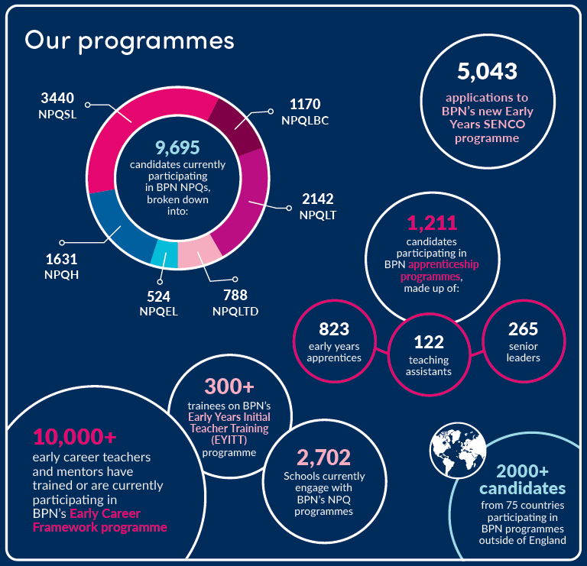
Best Practice Network & Outstanding Leaders Partnership
Every child able to benefit from an excellent education, regardless of background
Every education professional able to grow and give their best
Inspire Learning
Strive for
Excellence
Work
Together
Act with Integrity
Known & Trusted | | | 96% Satisfaction
‘Exceptional’ Provision | | | 96.1% Pass Rate

Slide 9
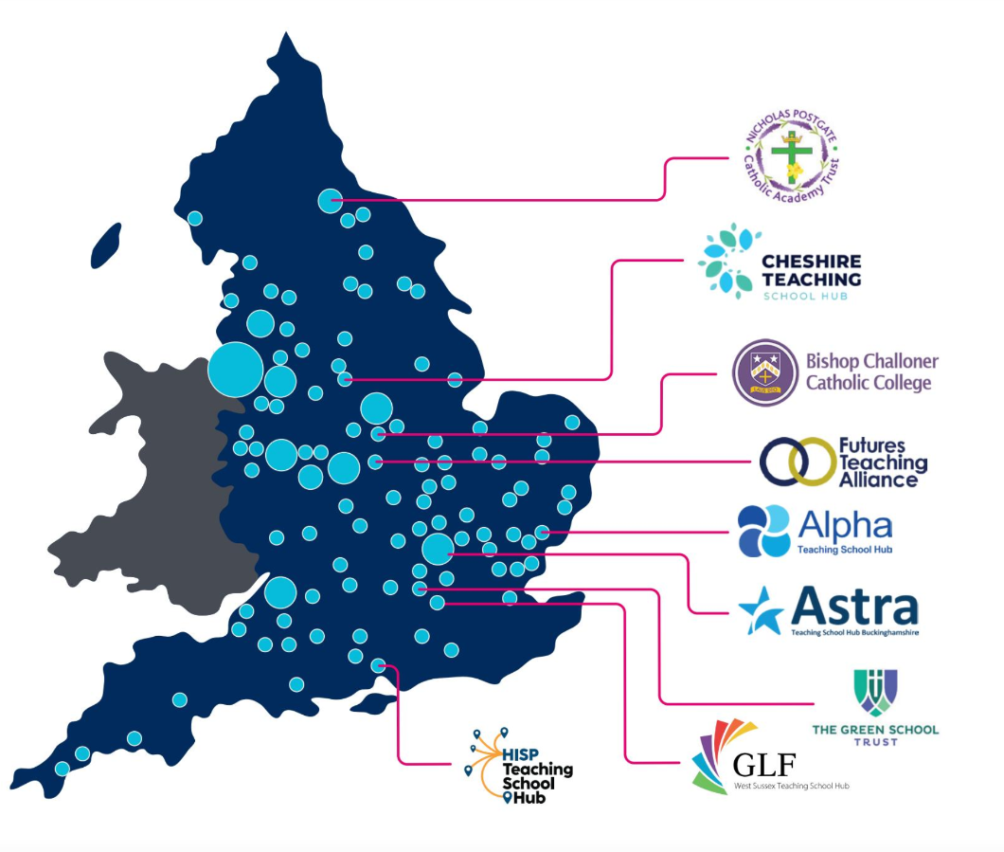
Local Groups, Nationwide Delivery
NPQs are delivered in partnership with TSHs, MATs and other schools groups across England
Face-to-Face events are facilitated by local school leaders familiar with local challenges and contexts
As most applications are received in July, we are unable to confirm viable groups until later in the year. However, we expect to be running groups in the same places we did in 2022
Growing number of international partners delivering NPQ Face-to-Face events, although the majority of international NPQs are delivered remotely. Contact us for your nearest international NPQ group

Slide 10
NPQLT Perspectives

Slide 11
Funding – England only
Scholarships
From autumn 2022, the organisations eligible to access scholarships are:
state-funded schools
state-funded 16 to 19 organisations
independent special schools
virtual schools (local-authority-run organisations that support the education of children in care)
hospital schools not already included in other categories of eligible organisations
young offender institutions
Targeted support funding
The Department has updated the Targeted Support Fund offer for the 2023 to 2024 academic year to further incentivise state-funded schools and state-funded 16 to 19 educational settings in England to participate in NPQs.
For each teacher or leader they employ who takes an NPQ in the 2023 to 2024 academic year:
state-funded primary schools with one to 150 pupils will receive a grant payment of £800
state-funded primary schools with more than 150 pupils will receive a grant payment of £200
state-funded secondary schools and state-funded 16 to 19 educational settings with one to 600 pupils will receive a grant payment of £200

Slide 12
Next steps Contacts Q&A
NPQLT can be viewed at www.bestpracticenet.co.uk/npqlt
International candidates should visit https://www.bestpracticenet.co.uk/NPQLT-International
Download qualification specifications
Discuss with school CPD lead, headteacher or relevant senior leaders
Contact us through the live chat function on our web site, enquiries@bestpracticenet.co.uk or phone 0117 920 94028
Apply sooner rather than later to avoid the last-minute rush!

