Slide 1

Leadership National Professional Qualifications (NPQs)
An introduction to the leadership NPQH programme (Headship)
Notes:
Welcome
Intros:
Bec – Marketing Executive
Lyndon Evans – NPQ graduate, facilitator and executive principal
Panelists: Martin Barratt, Nicholas Paul Belcher, Samuel Bourne
LPC
Welcome
Info and insight into the leadership NPQs, what’s different about them from the previous iteration of NPQs, who enrols on which programmes and an insight into BPN’s approach and programmes

Slide 2
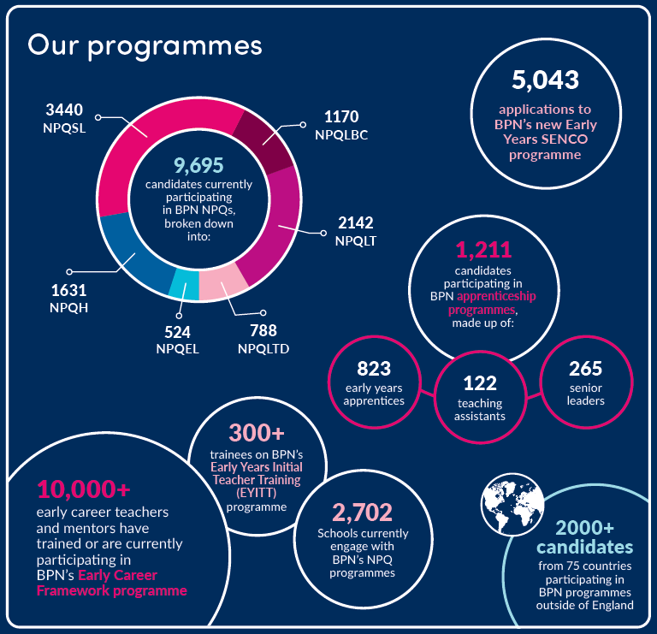











Best Practice Network &
Outstanding Leaders Partnership
Every child able to benefit from an excellent education, regardless of background
Every education professional able to grow and give their best
Inspire Learning
Strive for
Excellence
Work
Together
Act with Integrity
Known & Trusted | | | 96% Satisfaction
‘Exceptional’ Provision | | | 96.1% Pass Rate
2
Notes:
What we stand for – when choosing a provider like ours, it’s important to consider the values and approaches through which we operate
We’re here to get best leaders for all children, no matter where they are in the world – v important to us
The NPQ work supports your professional learning, through the prog and more importantly ensuring that you’re even better leaders at the end of the programme than you were at the beginning get the best for our children and schools
Inspire your learning, work together, act with integrity, and we want the best, so if you do too we do strive for that excellence
Data on slide – insight into width and depth – large PD provider, NPQs since 2012
We are all really proud to be here with colleagues this evening to share with you this new era of the NPQs in this reformed iteration

Slide 3
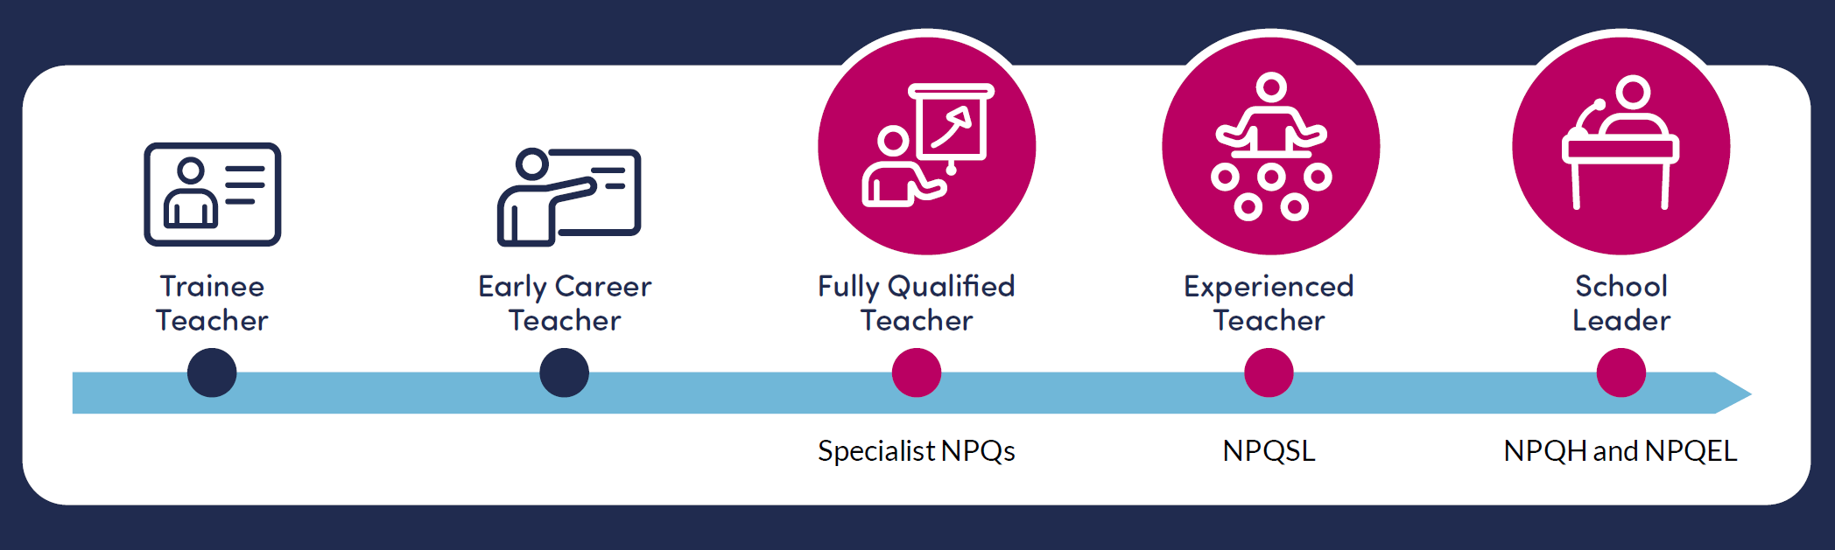
NPQ programmes: what changed in 2020?
So what’s changed?
Through the revised Initial Teacher Training Core Content Framework and the implementation of the Early Career Framework, the DfE are now supporting teachers in the first years of their career with a structured two-year induction into the profession
NPQ content areas are threaded from the Early Career Framework
The NPQs and New Headteacher Programme build on this foundation to provide continuous career pathways with training and support for teachers and leaders at all levels (with Teaching content from the ECF in all of the specialist NPQs)
The revised suite of specialist and leadership NPQs will complete the golden thread from initial teacher training through to school leadership, rooting teacher and leader development in the best available evidence and collective wisdom of the profession
Notes:
USE HEADLINE INFO ONLY
We want to start by providing some clarity about the journey and development NPQs have gone through
The NPQs have become part of a very clear career pathway which starts with the trainee teacher and ITT, into the ECF and then onto NPQs with the specialist route programmes, and then senior leaders, headteachers and executive leaders – brings everything together, and provides a very clear pathway and golden thread that the government have been keen to create
CLICK
ITT and ECF means early career teachers are supported in the first 2 years of their teaching careers
The NPQs follow on from there and many of the NPQ content areas are threaded from the ECF
Rooted in evidence and collective excellent practice from the profession

Slide 4
NPQ programmes: what changed in 2020?
Specialist NPQs
Leadership NPQs
NPQ Leading Teaching (NPQLT) | For those who lead, or aspire to lead teaching in a subject, year group, key stage or phase
NPQ Leading Teacher Development (NPQLTD) | For those who lead, or aspire to lead the development of other teachers
NPQ Leading Behaviour & Culture (NPQLBC) | For those who lead, or aspire to lead behaviour and culture and/or pupil well-being
NPQ Senior Leadership (NPQSL) | For those who are, or aspire to be, senior leaders leading across a school
NPQ Headship (NPQH) | For those who are, or aspire to be, headteachers leading across a whole school
NPQ Executive Leadership (NPQEL) | For those who are, or aspire to be, executive leaders with responsibility across more than one school
So what’s changed?
Specialist NPQs support career pathway width and replace old NPQML
Assessed school-improvement projects have been replaced with practice-based formative and summative assessment tasks
Behaviours do not feature in DfE frameworks, however, BPN have embedded these throughout
Greater emphasis on practice-based activity and participant context – practice activities, leadership performance coach
Domain-specific evidence base
Notes:
USE HEADLINE INFO ONLY TO POSITION LT
There are 6 NPQ programmes – this list is growing to include the new NPQLL and NPQEY
In developing the width of the pathway, the old NPQML has been replaced by the NPQLT, NPQLTD and NPQLBC which provides more choice, opportunity and sense of direction for school leaders, and to become better at what we do and to be able to make the difference to the young people we work with
12 months long, followed by assessment, built upon ECF, support career pathway
The 3 leadership programmes: leadership (SL, H and EL) – more familiar – but content and its delivery is different and they last 18 months + assessment
No project – FATs and SAT
No longer any leadership behaviours in the DfE frameworks. But BPN have a set of leadership behaviours and skills there are embedded throughout, to enable participants to apply new knowledge into their practice as a leader
Greater emphasis on practice-based activity and participant context – practice activities and FATs based in school
Domain-(school-)-specific evidence base as opposed to generic evidence-base from previous iterations
All leadership programme participants have an LPC who supports participants through their online learning and provides 1-1 coaching.

Slide 5

Who can apply?
Some example applicants. Contact us if you are unsure of your eligibility

Slide 6
Programmes overview: content areas
DfE Framework Content Areas: Leadership NPQs (NPQSL, NPQH, NPQEL)
1. School Culture
2. Teaching
3. Curriculum & Assessment
4. Behaviour
5. Additional and Special Education Needs/Disabilities
6. Professional Development
7. Organisational Management
8. Implementation
9. Working in Partnership
10. Governance and accountability
Notes:
All 6 of the NPQs are based on content areas which hold a series of learn that and learn how to statements
The content areas have been designed by the DfE and they appear in the DfE’s NPQ frameworks – Tom, would you mind adding a link to the main NPQ frameworks page on the DfE’s website to the chatbox please?
This slide shows you that the leadership programmes cover all ten content areas over the 18-month period of your programme
The structure of all of the leadership programmes ensures that all of the content areas are covered over the 18-month period, as indicated on the following slide.
At every point participants complete a Leadership Development Record which tracks progress and ensures relevance for you as individuals
Underpinning all of these content areas is a very strong and clear evidence base and resource list which is found in each framework. These will be presented throughout your programmes to exemplify what the content areas look like in practice, to bring them alive in given contexts and then to challenge you through various different kinds of activities to apply them with relevance to you and your schools. In addition, there examples of how other practitioners in those roles have applied the learn that statements in a specific content area into practice.

Slide 7
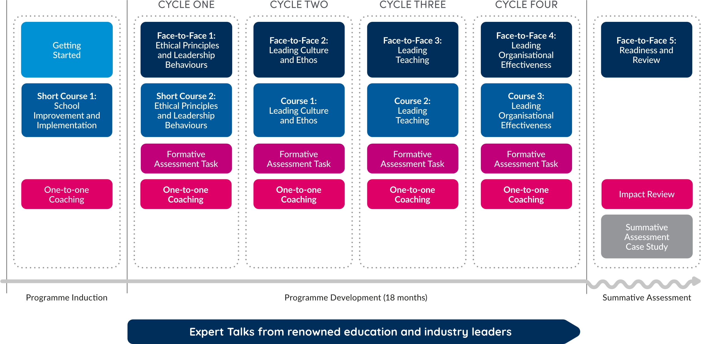
Programme Structure
Notes:
All of BPN’s leadership NPQ programmes follow these learning stages
The development stage occurs 4 times: cycles 1, 2, 3 and 4
Each cycle covers different content areas
3 stages to programme: induction, development and assessment
Induction cycle- short course on implementation
Development: Cycles 1-4 – FTF events, online course study, practice activities , FATs and performance 1-1 coaching.
Expert talks- Live online events led by external speakers through the leadership NPQs, followed by a live discussion board
Final F2F day is a review of leadership learning and readiness for assessment
Summative assessment stage- case study completion
These 4 stages are common to all 4 of the leadership NPQs.

Slide 8
Leadership NPQ programmes: assessment
18-month programme followed by summative assessment task
Case study (will only cover content which is referred to in the NPQ Content Framework)
SAT will allow participants to demonstrate understanding of the DfE’s NPQ Framework ‘learn that’ statements and how they can successfully apply this new knowledge through the ‘learn how to’ statements
The SAT will have its own mark scheme and marks will be awarded for both 'learn that' and 'learn how to' statements
The SAT submission is 1,500 words (up to an additional 1,000 words can be used if required): participants receive the unseen case study at the start of an eight-day assessment window and submit their response by midnight of the eighth day
This SAT window falls 18-21 months after the start of the programme.
Participants are required to meet 90%+ engagement as well as a successful SAT to pass their programme
Notes:
USE HEADLINE INFO ONLY
No longer a school improvement project - now a final case study assessment
Application of learning in practice is now the focus and the final assessment follows the 18 months of engagement and learning through an unseen case study scenario where responses will reflect the ten content areas and associated learn that and learn how to statements.
Length is 1500 words, (up to an additional 1,000 words can be used if required
Completion is within a fixed 8-day period; it is an open book assessment which is done online.
Additionally, participants need to meet the 90% engagement KPI across the programme elements as well as a successful SAT to pass

Slide 9
NPQH:
Participant and partnership perspectives
Notes:
Now I’m going to invite xxxxxxxxxxxxxxxxxxxxxxxxxxx who has been both a participant and a is a partner
into the discussion to give her perspective as a partner with a number of participants reengaged in the leadership NPQ programmes with BPN
Would you like to give a bit of context and a quick overview, xxxxxx, of your experiences so far with participants from your hub engaging in the leadership NPQ programmes…
Partner and participant
Potential discussion topics between partner, participant and xxxxx:
Examples of the roles and pathways participants on these programmes are in your partnership
Real and current case studies of best practice
Evidence
Myths and misconceptions
Leadership performance coach
Up to date reflections of engagement
Commonly arising questions from participants?
No project!!!!!
Thank you xxxxxx – hugely insightful and brilliant to hear about the place the leadership NPQs have in xxxxxx teaching school hub

Slide 10
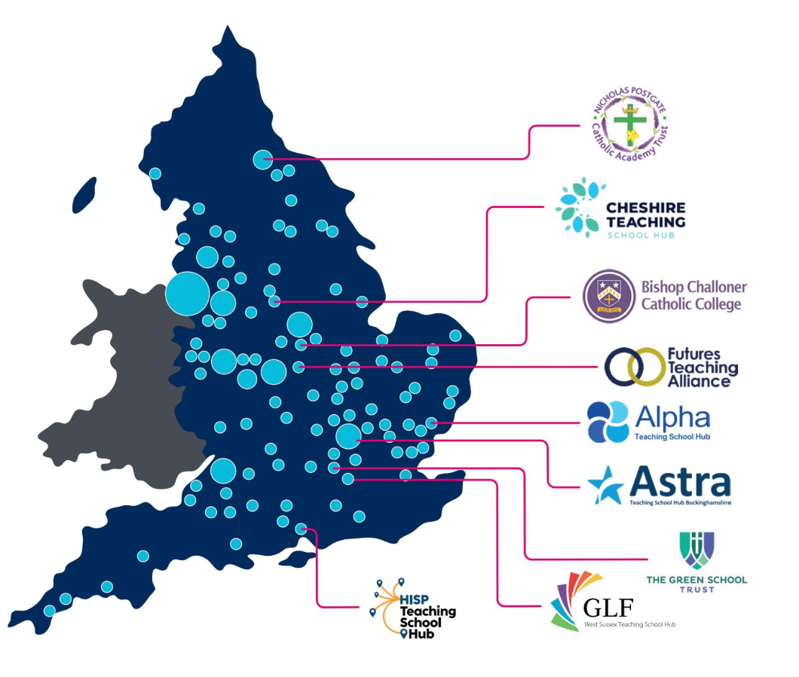
Local Groups, Nationwide Delivery
NPQs are delivered in partnership with TSHs, MATs and other schools groups across England.
Face-to-Face events are facilitated by local school leaders familiar with local challenges.
As most applications are received in July, we are unable to confirm viable groups until later in the year. However, we expect to be running groups in the same places we did in 2022. See 2022 Group Map here.
We have a growing number of international partners delivering NPQ Face-to-Face events, although the majority of international NPQs are delivered remotely. Contact us for your nearest international NPQ group.
Notes:
Maybe bring on a partner here?
National qualifications delivered in local venues using local facilitators where possible

Slide 11
Funding – England only
Scholarships
From autumn 2022, the organisations eligible to access scholarships are:
state-funded schools
state-funded 16 to 19 organisations
independent special schools
virtual schools (local-authority-run organisations that support the education of children in care)
hospital schools not already included in other categories of eligible organisations
young offender institutions
Targeted support funding
The Department has updated the Targeted Support Fund offer for the 2023 to 2024 academic year to further incentivise state-funded schools and state-funded 16 to 19 educational settings in England to participate in NPQs.
For each teacher or leader they employ who takes an NPQ in the 2023 to 2024 academic year:
state-funded primary schools with one to 150 pupils will receive a grant payment of £800
state-funded primary schools with more than 150 pupils will receive a grant payment of £200
state-funded secondary schools and state-funded 16 to 19 educational settings with one to 600 pupils will receive a grant payment of £200
Notes:
Jamie Slide
Whilst there are no scholarships available for international participants (many of whom will be present), the fact that the DfE pays for scholarships should add to the prestige of the NPQs in the eyes of our international attendees

Slide 12


Headteacher Programme with NPQH
The Headteacher Programme with NPQH is a dual award which has mapped the DfE's NPQ for Headship (NPQH) to the Level 7 Senior Leaders Standard.
By mapping the two qualifications, we have created a programme which allows participants to complete two qualifications concurrently with a much smaller workload than would be required if completing the qualifications separately.
Benefits for participants
Access extra 1:1 coaching and content
Extend your leadership training
Gain an additional qualification
Train at no cost to you or your school
Access to FranklinCovey resources
Funding through the Apprenticeship Levy
Learn more in our webinar June 29 @5pm
https://bestpracticenet-co-uk.zoom.us/j/87970549011
Or visit:
https://www.bestpracticenet.co.uk/headteacher-apprenticeship-npqh

Slide 13
Next steps
  NPQH can be viewed at https://www.bestpracticenet.co.uk/npqh
  International candidates should visit https://www.bestpracticenet.co.uk/npqh-international
  Download qualification specifications
  Discuss with school CPD lead, headteacher or relevant senior leaders
  Contact us through the live chat function on our web site, enquiries@bestpracticenet.co.uk or phone 0117 920 94028
  Apply sooner rather than later to avoid the last-minute rush!
  Applications close 25 July
Notes:
Next steps
Consider which programmes are best for you or for colleagues in school.
Straightforward slide – do utilise those contacts for ensuring you have all the information you need
Thank you to you all for joining and to everyone in the team who has contributed and will be getting those FAQs out as necessary
Get your applications before the Winter break in to guarantee spaces
Q&A – Tom to lead
Thank you and good evening
Q&A
Eligibility for funding and scholarships – Tom
Eligibility to apply
No hard cap on applications for BPN, but DfE does have a cap on the amount of money they can spend
SAT – unseen case study. Throughout the programme have included opportunities to help you become familiar with the language and structure in F2F days, choices of practice activities and FATs
BPN-own assessment centre – arms length from us in delivery team in order to maintain ethics – then internal moderation, then national moderation
If don’t pass, can resubmit using a different case study SAT
Decision about gaining qualification also aligned to DfE’s compliance measure of 90% engagement (+ successful assessment SAT)
NPQH placement task has gone, however practice activities recommend H and EL do apply practice in a different context to their own
All progs are for aspirant colleagues – if aspiring SL – apply to SL
Post links to website for eligibility and requirements
FAQ for outstanding questions - Tom

Slide 14


