Slide 1
Early Years Initial Teacher Training (EYITT)
Graduate Employed Based (GEB)
Foundation Stage Pathway (FSP)
September 2026
Notes:
Welcome and introductions from team
Open to EVERYONE -so anyone who works in the early years, anyone who has started an application, anyone who expressed an interest AND people who have already submitted an application!
Share information about the programme and answer any questions you may have!

Slide 2
Why train with us?
Notes:
We are the largest EYITT training provider having trained and assessed many candidates for Early Years Professional Status and subsequently EYITT since 2007. We have created a childminder offer to support your individual journey through the course.
Numbers of trainees are increasing each year, based on extremely positive feedback. 98% students would recommend the programme to a friend or colleague.
We have successfully supported a wide variety of trainees to achieve Early Years Teacher Status including those employed in early years and graduates wishing to enter the early years work force.
We offer a successful blended training programme with face to face and e learning components that helps manage study and learning alongside professional and working commitments of those on the route for employed people.
We offer an excellent personalised approach with each trainee being supported by a personal tutor and a work based mentor . Many of our tutors and mentors are early years teachers themselves.
We have a very high success rate of achievement of Early Years Teacher Status. It is a rigorous and challenging year – but you will be supported very well.

Slide 3

Early Years Teacher Status
Become an expert in leading teaching across the Birth to 5yrs age range
Train for free with DfE funding
£7000 incentive funding to support settings fund time out on placements and training days
Gain up to date subject knowledge on best practice in the Early Years
Teach in Reception class in academies and free schools with EYTS
Develop leadership skills to support successful team development in the setting and work with other professionals
Increase and improve support for children and families in the Early Years
Notes:
Not QTS!
Signpost to Primary/secondary ITT if QTS

Slide 4
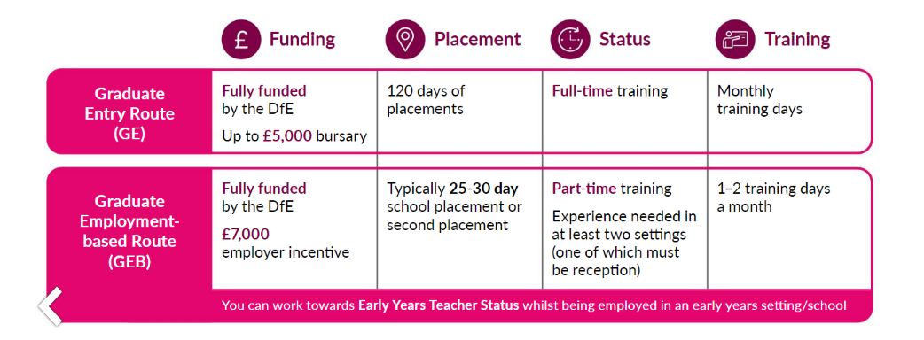
Introduction to the Routes
Notes:
Explain difference e.g. GEB=employed GE=not employed!
Fully funded by the government- employer incentive or
GE Bursary
1st/Masters £5000
2:1 £4000
2:2 £2000

Slide 5

Graduate Employment Based (GEB) Foundation Stage Pathway (FSP
We recognise that employment-based and school-based student teachers work within diverse educational settings and are uniquely positioned to make a meaningful impact on outcomes for children and families.
In response to this, our provision for student teachers will be individually tailored to reflect their specific circumstances and professional context, while ensuring all requirements of the EYITT course are met.
Notes:
We have had childminders completing EYITT in our past cohorts. We have developed a childminding group made up of PTs, facilitators who all have cm experience or have worked with childminder students. Their role is to look at specially tailoring the programme to childminders and celebrating the amazing work that they do!

Slide 6

What is the programme like?
Face to face or virtual sessions for training days
Online platform for uploading work and assessment and accessing modules
A dedicated tutor to support you throughout the programme
A lead trainer in setting to help organise training, study time and placements
A setting and placement mentor to support and observe you each week
Individual plan to help you make progress and offer challenge

Slide 7
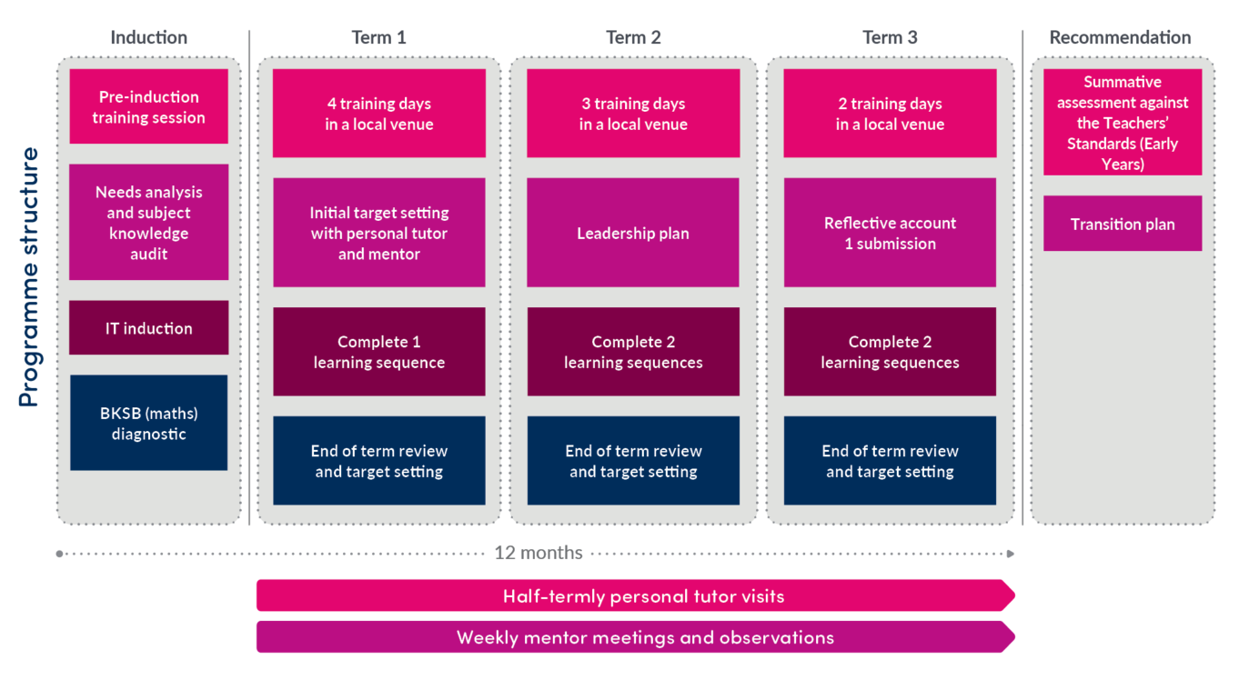

Programme Structure

Slide 8
EYITT Curriculum Map
Curriculum knowledge
Pedagogy
Adaptive
education
Theory into
practice
Our curriculum is:
Broad and balanced
Relevant
Forward thinking
Key themes for ITT
Focus on safeguarding, leadership and well-being, will also be threaded through each training day.
Child
Safeguarding
EYFS
Assessment
Understanding
behaviour
Continuum
of learning
Leading and
supporting
Child
development
Professional
responsibilities
Notes:
The EYITT curriculum encompasses the totality of trainees’ learning experiences throughout their time on the programme. Our curriculum is broad, balanced, relevant and forward thinking in order to meet the needs of the Early Years sector and raise outcomes for all children. Immersion in the curriculum and the experiences it offers will prepare trainees for their future career as Early Years Teachers.
The EYITT program combines in-person and online learning, practical experiences, and teaching observations. It focuses on enhancing student teachers' understanding of the Early Years Foundation Stage (EYFS) and the National Curriculum, as well as developing their leadership skills. Student teachers are expected to demonstrate their achievement of the Teachers’ Standards (Early Years) through their personal practice.

Slide 9
Training Days
Day 1-The Effective Early Years Teacher
Day 2-Adapting Teaching for the Unique Child
Day 3-Starting Strong
Day 4- Foundations for success
Day 5-Leading and supporting in the Early Years
Day 6- Promoting Equality, Diversity and Inclusion
Day 7-Unlocking potential and widening opportunities
Day 8-The Reflective EarlyYears Teacher
Final Interview (virtual)

Slide 10

Helping you to succeed!
Tutor
Mentor/Lead Trainer
Lead Tutor
Individual needs- ALN and Neurodiversity Network
Wellbeing support
EAL network group and support strategies
Visits, meetings, emails, discussions, training
Resource bank- modules, padlets, study packs, playlist, curriculum enhancements
Workshops e.g. Reflective account

Slide 11

How do we achieve this:
• Support prior to interview via a telephone or Teams call regarding any questions such as funding for the programme.
• During interview, student teacher’s individual circumstances are discussed and recorded alongside their prior experiences highlighting specific requirements.
• Once on programme, initial contact checklist (IVC) is completed in discussion with the student and mentor, along with the initial needs analysis which helps to plan out the journey from start to finish. This will include a discussion around individual placement requirements.

Slide 12

The role of the setting/placement mentor
Support can be offered to help you find a suitable mentor.
Mentors are ‘expert colleagues’ who will help you to develop your skills and knowledge as an EY Teacher
Mentors will share their experience, expertise and skills on different aspects on the curriculum
Observe you each week and give detailed feedback
Set SHARP targets to help you progress and master the Early Years Teaching Standards
Plan and monitor your time spent and work completed in each age group
Notes:
Flexi- mentors if needed!

Slide 13
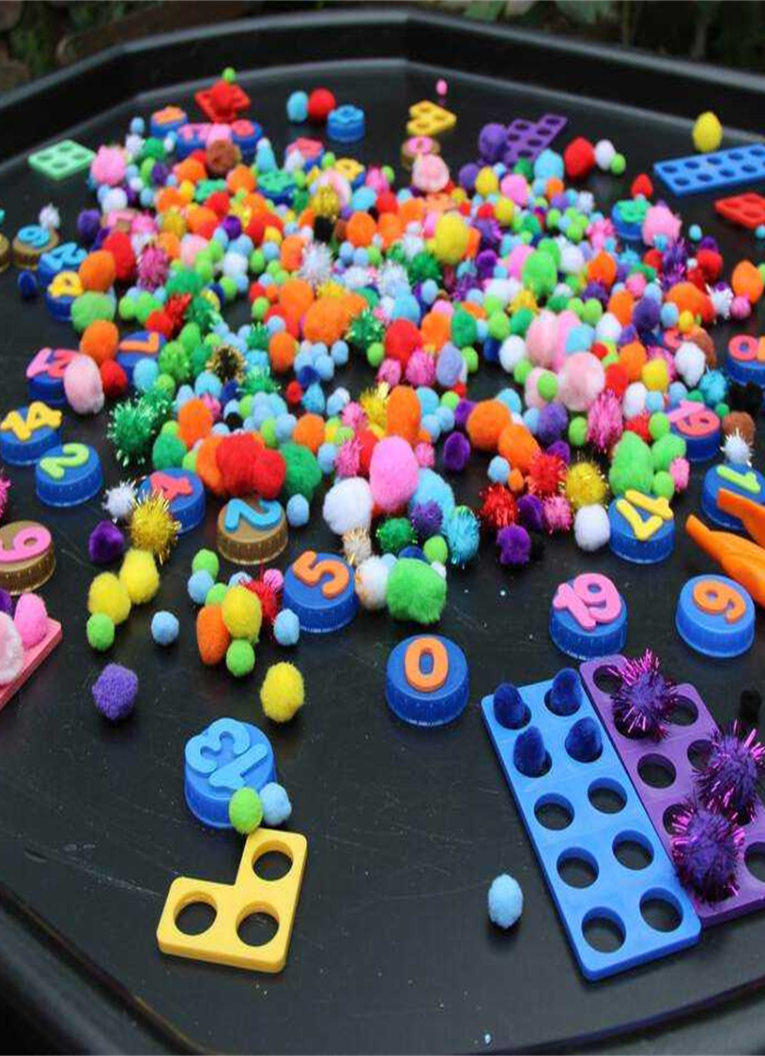
ITT requirements for placement
Every student must cover the age groups from 0-5 years as a minimum (DfE requirement)
All students must complete a placement of at least 25 days.
Placements will depend on the ages of children that you work with in your setting.
Placements need to offer a variety and depth of experience to enable student teachers to meet all of the Early Years Teaching Standards
Placements are completed in at least 2 different settings. (These must be expected/strong or exceptional) Your own setting is setting number one! Some students may need 3 settings.
Placements must be in a setting which delivers the EYFS or works to National Curriculum expectations

Slide 14

How is Early Years Teacher Status assessed?
Formatively which leads into summative assessment
Ongoing assessment which includes observations, a reflective account, sequences of work and termly targets
Demonstration of mastery of the EYITT curriculum
A summative judgement that each student teacher meets the Teachers’ Standards (Early Years)
Exam board and recommendation for the award of Early Years Teacher Status

Slide 15

What are the entry criteria?
A degree (or equivalent Level 6)
GCSE in English, Maths and Science at grade C/ grade 4 or above…. or a recognised equivalent
The right to study and work in the UK
Competence in spoken and written English
A satisfactory DBS check
For all students: meeting the health and physical capacity to teach requirements

Slide 16

Equivalency Tests
GCSE Qualifications and equivalency tests
If applicants do not hold GCSEs in maths, English or science (no grade C/4 or above), they can complete equivalency tests.
*GCSE science equivalency test can be either Biology or combined.
We will accept equivalency tests from:
https://astarequivalency.co.uk/
Or any other equivalency provider!

Slide 17

Maths for free!
If applicants require their maths equivalency test, they can complete this through BPN:
Our Maths assessment and upskilling platform will enable them to meet the ITT requirements to access our programmes
*May not be valid with another provider

Slide 18



We can help you take the next step!
Have a look on our website:
www.bestpracticenet.co.uk/eyitt
Check out our new childminder website page!
Talk to our team
EYITT@supportingeducation.net
@bestpracticenet
facebook.com/bestpracticenetwork/

Slide 19

Any Questions?
Don’t miss the deadline to apply!
Or recruitment Window closes on 28th August 2026
Get those applications in fast!

