Slide 1


Slide 2


Congratulating our TA of the year winners!
Welcome! Thanks for joining us
Happy National TA Day!
Introducing 3 programmes from Best Practice Network
Q&A with
Best Practice Network

Slide 3


Slide 4




Teaching Assistant Level 3 Apprenticeship
  The Level 3 Teaching Assistant (TA) programme is ideal for anyone already working in or looking for a career in a teaching support role.
  All learners will gain, as a minimum, the fundamental knowledge and develop the skills & behaviours required to support teachers to enhance pupil learning either in groups or individually.
  Learners will also be able to personalise their pathways based on their choice of specialist area(s).
  The programme lasts for 15 months plus EPA.
The Level 3 Teaching Assistant (TA) programme is ideal for anyone already working in or looking for a career in a teaching support role.
All learners will gain, as a minimum, the fundamental knowledge and develop the skills & behaviours required to support teachers to enhance pupil learning either in groups or individually.
Learners will also be able to personalise their pathways based on their choice of specialist area(s).
The programme lasts for 15 months plus EPA.

Slide 5


An apprenticeship can be for new or existing staff but must cover new learning
What is an apprenticeship?
Apprentices get a paying job with valuable training while they work towards a nationally recognised apprenticeship standard
Apprenticeships are work-based training programmes that are designed to help employers train people for specific job roles

Slide 6

Affecting behaviour, attitudes, and aspirations
Contributing to positive relationships
Providing consistency and familiarity
Observing and reporting on pupil performance
Providing specialist support
What are the benefits of the TA apprenticeship?
Helping understanding
Developing social skills
Developing a love of learning
Developing independence
Developing social skills
Supporting emotional well-being
Providing support for learning activities

Slide 7

Who is a TA apprenticeship for?
Learners must:
  Be employed as a Teaching Assistant with support from your school and levy account holder/Apprenticeship Service Account holder
  Have the support from your Line Manager/designated Mentor to work with you throughout the programme. They will also support you with the 20% off-the-job training including webinars, portfolio preparation, shadowing, reading and time to attend review meetings. As well as set the plan for the on-the-job training according to an Individual Learning Plan
  Have GCSEs in English and maths at Grade C (4) or above or able to achieve Level 2 English and Maths whilst on the programme (fully-supported on a one-to-one basis)
  Have 5 GCSEs at Grade C (4) or above or equivalent and/or experience in the role or similar roles.
  Have held a residency in the UK for the last three years

Slide 8
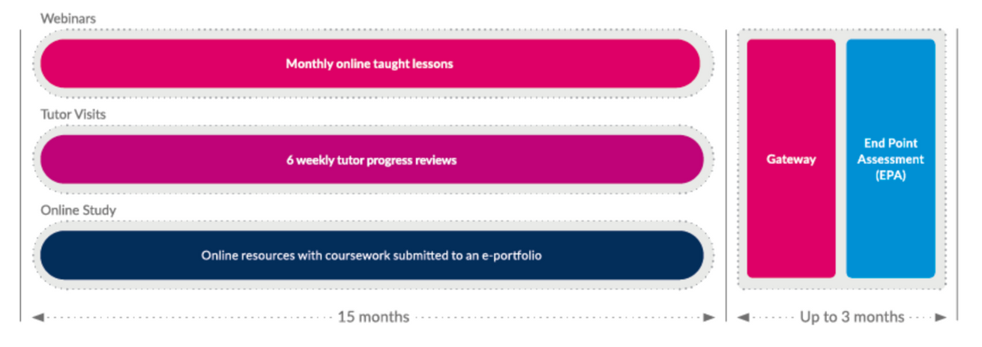

How is it delivered?
Delivery includes:
  Half-termly (4–6) Tutor on-site visits to carry
out observations and professional discussions
in the school workplace
  An extensive curriculum with 17 Knowledge,
16 Skills and 6 Behaviours that help support
the class teacher and enhance learning
  6-weekly remote or face-to-face online
reviews with the Tutor and the Head Teacher/
Line Manager/ mentor
  Reflective CPD online journal or blog
  One-to-one teaching sessions with a dedicated tutor
  Group webinars and online catch-ups
  HLTA competencies and career development
  Individual learning plans
8 Core modules covering
17 Knowledge statements
16 Skills
6 Behaviours

Slide 9
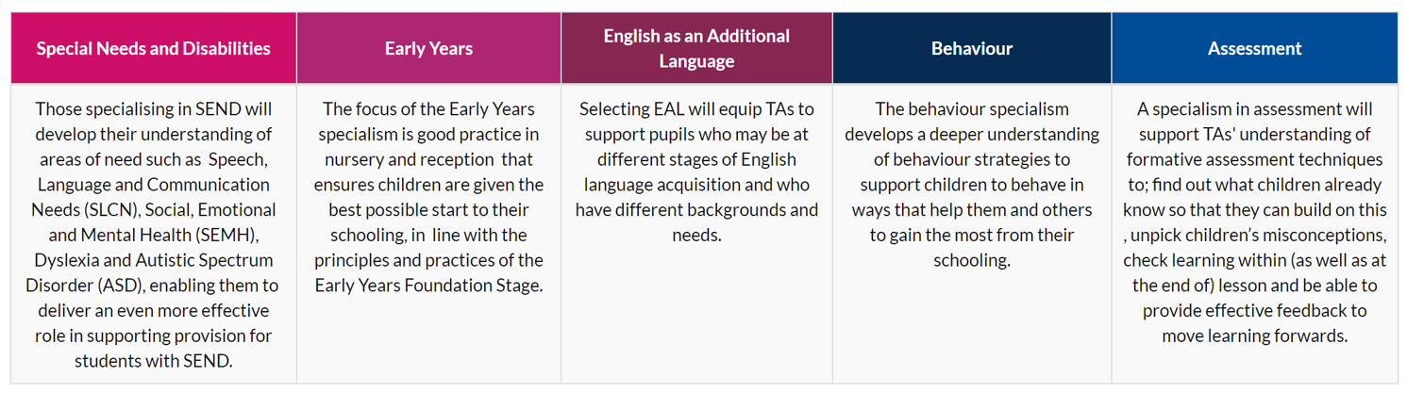
All learners must select and complete one accredited specialism on programme
  You can choose more than one but must ensure this is discussed with employer and tutor so that time spent on these specialisms does not interfere with the job role or with core apprenticeship course requirements
  Certificates for any specialisms successfully completed
  The specialisms become available six months after the apprenticeship start date
  We advise completion of one specialism any time between month 6 and month 11 and then to review the benefits or otherwise of any additional specialisms
Developing a specialist area

Slide 10

End Point Assessment (EPA)
Assessment Method 1: Practical Observation with Questions & Answers
  The practical observation will be carried out over 2 hours (+/- 10%). The Q & A will last for 15 minutes (+/- 10%) and will take place at the end of each observation
  Whenever possible the practical observation should be undertaken by an independent assessor over a period of one day with each session lasting for at least 30 minutes, depending on the needs of the employer and practical observation opportunities
  The practical observation must take place in the apprentice’s workplace
Assessment Method 2: Professional Discussion supported by portfolio of evidence
  The portfolio of evidence should be given to the independent assessor two weeks prior to the professional discussion taking place. Although this is not assessed by the independent assessor it will enable them to prepare for the professional discussion
  The professional discussion will last for a duration of 90 minutes (+/- 10%)
  The professional discussion will be a structured discussion between the apprentice and the independent assessor, following the practical observation, to establish the apprentice’s understanding and application of the knowledge, skills and behaviours

Slide 11



The next intake for the TA Level 3 Apprenticeship begins in November 2023
Apply by the 15th of October!
Successful learners will be eligible to apply for fast-track HLTA with BPN, once their level 3 qualification has been awarded.
Scan to apply
On programme, you will learn:
  The development of a specialist area/s (area of expertise)
  Familiarisation and use of HLTA assessment methodology, delivered in the context of level 3
  Familiaristaion with the HLTA Standards, and
a greater knowledge and understanding of whole class teaching
What next?
Progression routes
Visit: www.bestpracticenet.co.uk/TA

Slide 12

Higher Level Teaching Assistant
Status (HLTA)
19 years successful experience
99% pass rate
Available online nationwide
HLTA Status preparation with BPN helps you to prove this with:
  Evidence through written examples of your work
  Evidence through what you say, and what others say about you
  Evidence through documents you use
The Level 3 Teaching Assistant (TA) programme is ideal for anyone already working in or looking for a career in a teaching support role.
All learners will gain, as a minimum, the fundamental knowledge and develop the skills & behaviours required to support teachers to enhance pupil learning either in groups or individually.
Learners will also be able to personalise their pathways based on their choice of specialist area(s).
The programme lasts for 15 months plus EPA.

Slide 13
What is Standard
11?
To gain HLTA status, you need GCSE grade C or above in English and maths, or equivalent ‘level two qualification’
Apprenticeship and experience route
Experience route

Slide 14
  1.Preparation for Day One
4. Day 2 - Between 6-8 weeks after Day 1
2. Day One – Two sessions with work to do in between
5. Assessment day - Between 4-12 weeks after Day 2
How is it delivered?
6. Moderation - Success - Celebration!
3. Prepare draft tasks, other preparation materials

Slide 15

Writing about your work
The Level 3 Teaching Assistant (TA) programme is ideal for anyone already working in or looking for a career in a teaching support role.
All learners will gain, as a minimum, the fundamental knowledge and develop the skills & behaviours required to support teachers to enhance pupil learning either in groups or individually.
Learners will also be able to personalise their pathways based on their choice of specialist area(s).
The programme lasts for 15 months plus EPA.
You will be asked to write about your work. There are a lot of support materials, and we also check one of your draft practice pieces, you can:
  Write about a good one-to-one lesson
  Write about a good group lesson
  Write about a whole class! No teacher present!
  Write about 5 other things you did at work – other lessons, playground duty, assembly, incidents…

Slide 16

Documents for evidence
The Level 3 Teaching Assistant (TA) programme is ideal for anyone already working in or looking for a career in a teaching support role.
All learners will gain, as a minimum, the fundamental knowledge and develop the skills & behaviours required to support teachers to enhance pupil learning either in groups or individually.
Learners will also be able to personalise their pathways based on their choice of specialist area(s).
The programme lasts for 15 months plus EPA.
  One for each standard
  Single examples of learners’ work are great
  Photos of work or displays can be fabulous
  Extracts of policies or reports help to explain things
  Lesson plans you have used can be awesome

Slide 17

Discussing your work
On the day of the assessment, the assessor will speak with:
  Yourself
  A teacher who knows you well
  The Head Teacher or an appointed senior leader
They could ask about any standard for example 10/17/18 or 29/30/31
The Level 3 Teaching Assistant (TA) programme is ideal for anyone already working in or looking for a career in a teaching support role.
All learners will gain, as a minimum, the fundamental knowledge and develop the skills & behaviours required to support teachers to enhance pupil learning either in groups or individually.
Learners will also be able to personalise their pathways based on their choice of specialist area(s).
The programme lasts for 15 months plus EPA.

Slide 18

There are intakes throughout the year!
To apply please make sure you have your Headteacher declaration.
In a survey of our HLTA graduates, 91% answered that gaining the status had increased their confidence in their own abilities.
Scan to apply
In order to be accepted onto HLTA, prospective candidates must secure support from their Headteacher to:
  Confirm they consider you to be suitable to undertake the HLTA status.
  Confirm that you, the applicant, have undertaken whole class teaching with no teacher present on at least 2 occasions.
  Confirms they have seen documentary evidence that you, the applicant, hold a level 2 qualification in English/literacy.
  Confirms they have seen documentary evidence that you, the applicant, hold a level 2 qualification in Maths/numeracy.
Only applicants with a completed corresponding Headteacher declaration form will be accepted onto the qualification & offered a place in one of our delivery groups.
What next?
Visit: www.bestpracticenet.co.uk/HLTA

Slide 19

Initial Teacher Training (ITT)
The Postgraduate Teacher Apprenticeship is an alternative to traditional university-based teacher training.
Trainee teachers are employed by a school while learning on the job. Trainees are paid a wage on the unqualified teacher pay scale. They do not pay fees as funding comes by way of the Apprenticeship Levy.

Slide 20

Pathways from 2024
Postgraduate Teacher Apprenticeship - Primary
Postgraduate Teacher Apprenticeship - Secondary
Specialisms in:
  Ages 3-7
  Ages 5-11
  Primary SEND
Specialisms in ages 11-16 OR 14-19 in:
  English
  Maths
  Chemistry
  Biology
  Computing
  Geography
  French
  Spanish

Slide 21
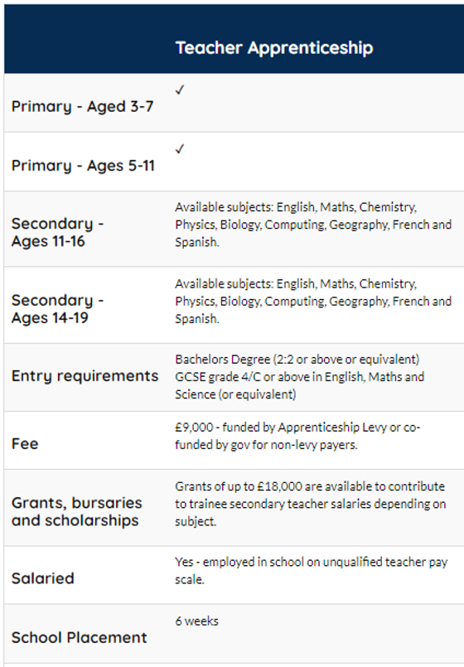

They do not pay fees as funding comes by way of the Apprenticeship Levy.
What is a Teacher Apprenticeship?
Trainees are paid a wage on the unqualified teacher pay scale.
Trainee teachers are employed by a school while learning on the job.

Slide 22

Key facts - what you need to know
  Fee - £9,000 funded by Apprenticeship Levy or co-funded by the government for non-levy payers
  Salary – Employed in a school on the unqualified teacher pay scale
  In-school mentor
  BPN Support – Personal apprenticeship tutor, centre-based training, subject-specific workshops, self-directed online learning modules

Slide 23
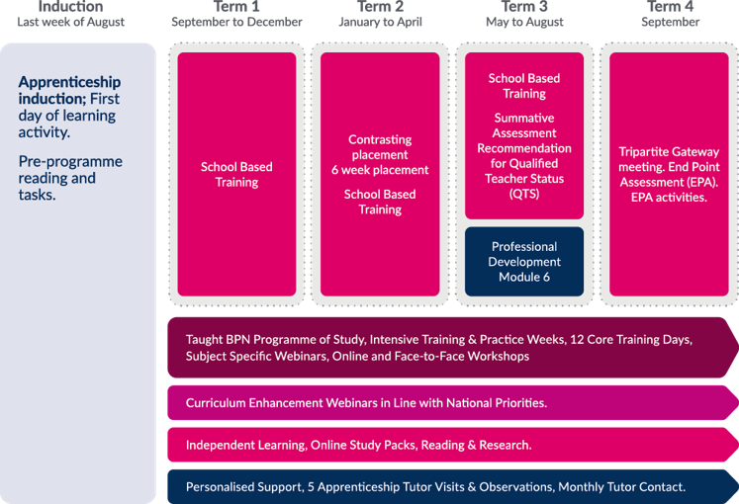
How is it delivered?
The ITT curriculum is made up of core modules over the course of the year which align with the CCF core areas.
Apprentices will spend four days per week in the classroom building up their learning and teaching experience and one day per week engaged in training which will be a combination of virtual and Face-to-Face experiences.
The ITT apprentice will spend Term 1 in their employer’s school. In term 2 they will have a placement in a contrasting setting for a minimum of 5 weeks before returning to their employer’s school for the remainder of the term. Term 3 is spent in your employer’s school and they will be assessed against the Teacher Standards (TS) in this term. Term 4 is when the end-point assessment (EPA) will take place.
Each module begins with an Intensive Teaching and Practice (IT&P) week. IT&P weeks are different from general School Based Training (SBT) as you will focus on selected aspects of the planned training curriculum through a combination of virtual and face to face experiences.

Slide 24

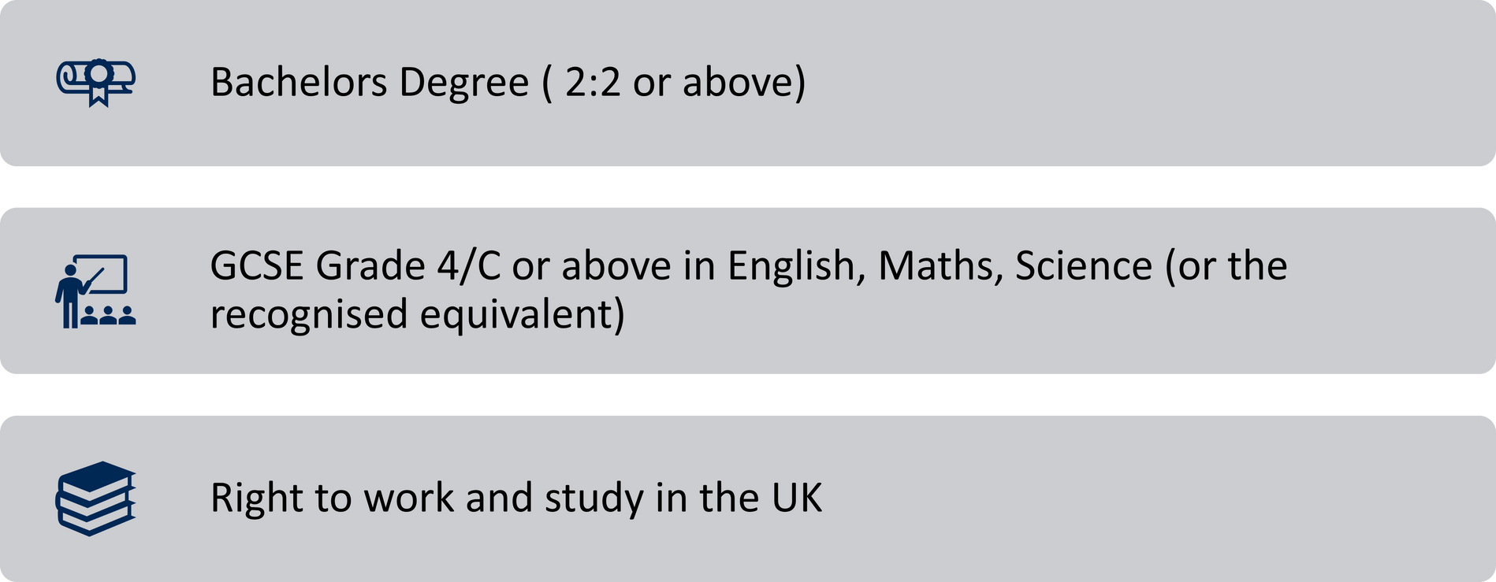
What are the entry requirements?
m
s

Slide 25


Slide 26



The next intake for the Teacher Apprenticeship is
September 2024!
If you have any questions please email teach@bestpractice
net.co.uk
Primary?
We are taking applications now!
Scan here
Secondary? Register your interest now
Scan here
Visit: www.bestpracticenet.co.uk/teacher-apprenticeship

Slide 27


If you want to talk to our team about the programmes we have discussed today, or any other opportunities, please get in touch!
Thank You!
Any Questions?
enquiries@bestpracticenet.co.uk
0117 920 9428

