Slide 1
Comparison between NPQ stand alone programmes and Apprenticeship programmes with NPQ’s

Slide 2
Apprenticeships with NPQ’s overview
 | Standalone NPQ’s |  |  |  | Apprenticeships including NPQEL, NPQH and NPQSL
 | Specialist NPQs | NPQSL | NPQH | NPQEL | Senior Leader Level 7and Operations or Departmental Manager Level 5 Apprenticeships
 | 12 month qualification plus 3 months Summative Assessment | 18 month qualification plus 3 months Summative Assessment |  |  | Senior Leader including NPQEL Headteacher Apprenticeship with NPQH ODM including NPQSL 18 months on programme plus 5 months (max) End Point Assessment
Preparation & induction | 6 hours |  |  |  | 4 hours
Face-to-face events | 3 days (18hrs) | 4 days (24hrs) | 5 days (30hrs) | 6 days (36hrs) | FDOL webinars 6 hrs (Safeguarding, H&S, BV’s, Prevent, C&M, e.safety) (19 x 4-weekly reviews = 19hrs, not included in OTJT hours) 1:1 support/delivery = 19 hrs observations = 7 hrs
Online course study | 34 hours | 38 hours |  |  | NPQSL: 1.5 hours every 2 months =12hrs NPQH: 1.5 hours every 2 months = 12hrs NPQEL: 1.5 hours every 2 months = 12hrs
Performance coaching | 6 hours | 10 hours |  |  | -
FATs (In-school Practice Application of learning) | 18 hours | 20 hours | 28 hours | 34 hours | Portfolio building NPQSL – 24 hours NPQH – 24 hours NPQEL – 24 hours
Summative assessment stage | Case Study scenario – 1500 words minimum – 8 hours |  |  |  | NPQSL – Project Proposal – 6 hours NPQH – Strategic Business Proposal – 8 hours NPQEL – Strategic Business Proposal – 8 hours
Total learning hours | 90 | 106 | 120 | 132 | Senior Leader including NPQSL = 78 additional = 184 total Headteacher Apprenticeship with NPQH = 80 additional = 200 ODM including NPQEL = 80 additional = 212 total

Slide 3
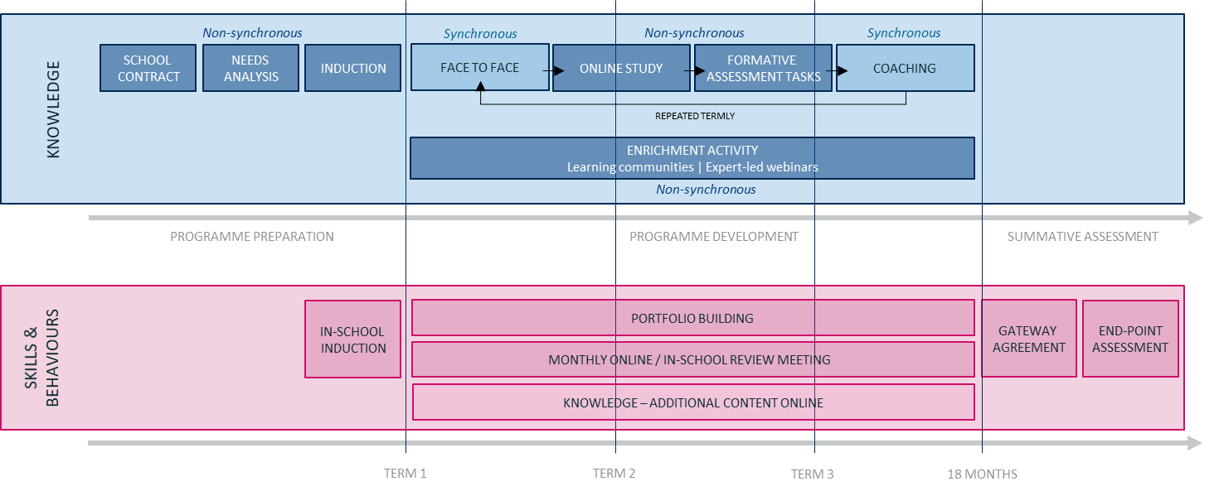
Apprenticeships that include NPQs

Slide 4
Qualifications gained
Senior Leader Apprentice Programme
The programme delivers the Operations or Departmental Manager Level 5 apprenticeship programme and includes the Department for Education’s leadership qualification NPQSL. Candidates accepted on to the programme benefit from:
Completion of Level 5 Departmental or Operations Manager standard apprenticeship
Full National Professional Qualification for Senior Leadership
Aligns with recognition by:
Chartered Management Institute – Full Member, The Institute of Leadership and Management – Full member

Slide 5
Qualifications gained
Headship Apprenticeship with NPQH
The Headship Apprenticeship with NPQH delivers the Senior Leaders Level 7 Apprenticeship and includes the Department for Education's leadership qualification NPQH. Candidates accepted on to the programme benefit from:
Completion of Level 7 Senior Leader apprenticeship standard
Full National Professional Qualification for Headship
Aligns with recognition by:
Chartered Management Institute – Chartered Fellow, The Institute of Leadership and Management – Fellow

Slide 6
Qualifications gained
Executive Leader Apprentice Programme
The Executive Leader Apprentice with NPQEL delivers the Senior Leaders Level 7 Apprenticeship and includes the Department for Education's leadership qualification NPQEL. Candidates accepted on to the programme benefit from:
Completion of Level 7 Senior Leader apprenticeship standard
Full National Professional Qualification for Executive Leadership
Aligns with recognition by:
Chartered Management Institute – Chartered Fellow, The Institute of Leadership and Management – Fellow

Slide 7
Cost difference
NPQEL standalone cost: £4095
Senior Leaders Apprenticeship including NPQEL cost: £14,000 from levy funds or co-investment for non-levy payers where the government pays 95%
£95.00 additional cost for NPQ certification
NPQH standalone cost: £1980
Headship Apprenticeship with NPQH cost: £14,000 from levy funds or co-investment for non-levy payers where the government pays 95%
£95.00 additional cost for NPQ certification
NPQSL standalone cost: £1140
Operations or Departmental Manager Apprenticeship including NPQSL cost: £7,000 from levy funds or co-investment for non-levy payers where the government pays 95%
£95.00 additional cost for NPQ certification

Slide 8
Delivery hours
Senior Leaders Apprenticeship including NPQEL – additional delivery of 80 hours
Headteacher Apprenticeship with NPQH – additional delivery of 80 hours
Operations or Deparmental Manager Apprenticeship including NPQSL – additional delivery of 78 hours.

Slide 9
Additionality
An apprenticeship focuses on the holistic development of the appropriate skills, knowledge and behaviours, designed in partnership with cross-sector industries, to ensure bespoke coverage of all the relevant requirement of leading and managing at a senior/executive level at your setting or across multiple organisations.
Engaging with an apprenticeship is both a challenging and rewarding commitment which will fully prepare you for the demands and rewards of senior/executive leadership.
Reading and engagement with research is a key aspect of developing as a leader and an apprenticeship further enhances this through practical application in areas such as Corporate Social Responsibility, Health & Safety legislation and Human Resource Management.
In addition, you will develop and consolidate your skills and knowledge in areas such as risk mitigation and contingency, contract terms and conditions, strategic financial planning along with funding and financial regulation. You will learn about, and apply, tools and techniques to develop and implement effective organisational projects, business continuity design and essential time and self-management techniques.

Slide 10
Summary
 | NPQSL standalone | Senior Leaders Apprentice Programme | NPQH standalone | Headteacher Apprenticeship with NPQH | NPQEL standalone | Executive Leaders Apprentice Programme
Learning hours delivered | 106 | 184 | 120 | 200 | 132 | 212
Qualifications gained | NPQSL | ODM Level 5 Apprenticeship NQPSL | NPQH | Senior Leaders L7 Apprenticeship NPQEL | NPQEL | Senior Leaders L7 Apprenticeship NPQEL
Cost | £1140 | £7000 (levy) | £1980 | £14000 (levy) | £4095 | £14000 (levy)

